Slide 1


Pandit Jawaharlal Nehru College of Agriculture and Research Institute, Karaikal – 609603.
Report on strengthening of infrastructure facilities of the
Department of Horticulture under DBT- Star College Scheme
Advisory Committee Meeting on 18.08.2025

Slide 2
COURSES OFFERED BY THE DEPARTMENT OF HORTICULTURE
B.Sc. (Hons.) Agriculture B.Sc. (Hons.) Horticulture M.Sc. (Horticulture) Vegetable Science Ph.D (Vegetable Science)

Slide 3
k. BUDGET EXPENDITURE
2023-24
Head | Amount Sanctioned (Rs.in Lakhs) | Expenditure Incurred (Rs.)
Non-Recurring | 10.00 | 9,99,400
Recurring | 3.00 | 2,99,317
Contingencies | 0.30 | 30,000
Total | 13.30 | 13,28,717
2024-25
Head | Amount Sanctioned (Rs.in Lakhs) | Expenditure Incurred (Rs.)
Recurring | 3.00 | 2,99,999
Contingencies | 0.30 | 30,000
Total | 3.30 | 3,29,999

Slide 4
B. Equipment’s Procured – Non Recurring Contigency
Sl.No | Name of the Equipment | Unit cost | No. of Unit | Actual Cost (Rs.)
1. | Work table with stainless steel top | 99,710 | 1 | 99,710
2. | Strapping machine for cartons | 2,940 | 1 | 2,940
3. | Handy PH & EC meter | 14,700 | 1 | 14,700
4. | Fruit & vegetables processing accessories | 19,845 | 1 | 19,845
5. | Brine meter | 14,910 | 1 | 14,910
6. | Shrink wrapping machine | 74,970 | 1 | 74,970
7. | Colour meter | 16,800 | 1 | 16,800
8. | Tomato fruit juice extractor | 1,995 | 1 | 1,995
9. | Continuous band sealing machine | 39,900 | 1 | 39,900
10. | Hot air oven | 79,905 | 1 | 79,905
11. | Micro oven | 16,905 | 1 | 16,905
12. | Weighing balance | 59,850 | 1 | 59,850
13. | Hand lever crown corking machine | 29,925 | 1 | 29,925
14. | Compound microscope | 34,965 | 2 | 69,930
15. | Deep freezer vertical | 96,495 | 1 | 96,495
16. | Vernier caliper | 13,924 | 1 | 13,924
17. | Pressure tester | 6,372 | 1 | 6,372
18. | Lux meter | 20,945 | 1 | 20,945
19. | Cabinet tray dryer | 94,962 | 1 | 94,962
20. | Fruit pulper | 87,360 | 1 | 87,360
21. | Mini hydro distillation unit | 38,055 | 1 | 38,055
22. | Leaf area meter | 99,002 | 1 | 99,002
Total |  |  |  | 9,99,400

Slide 5
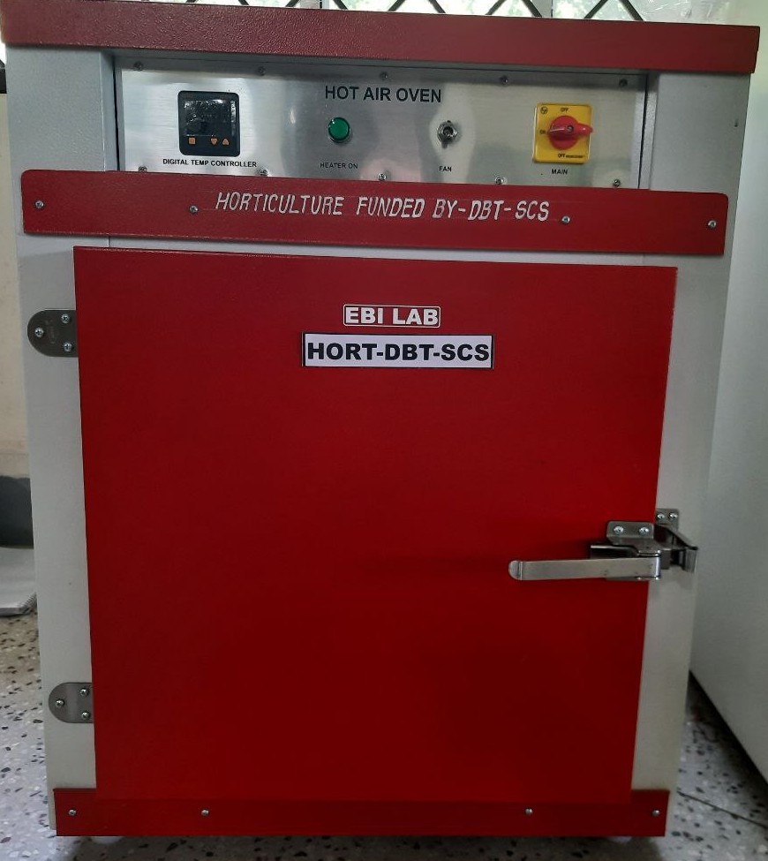
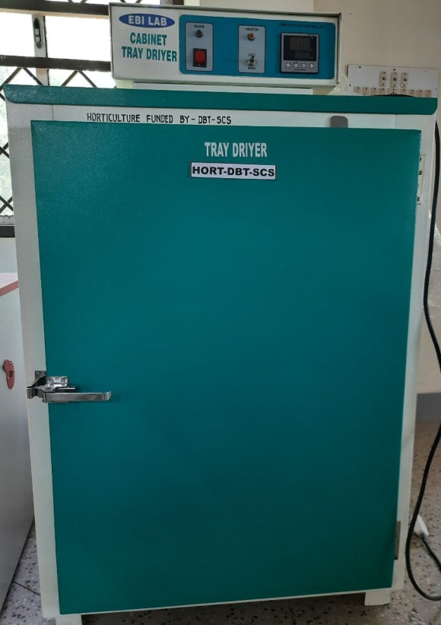
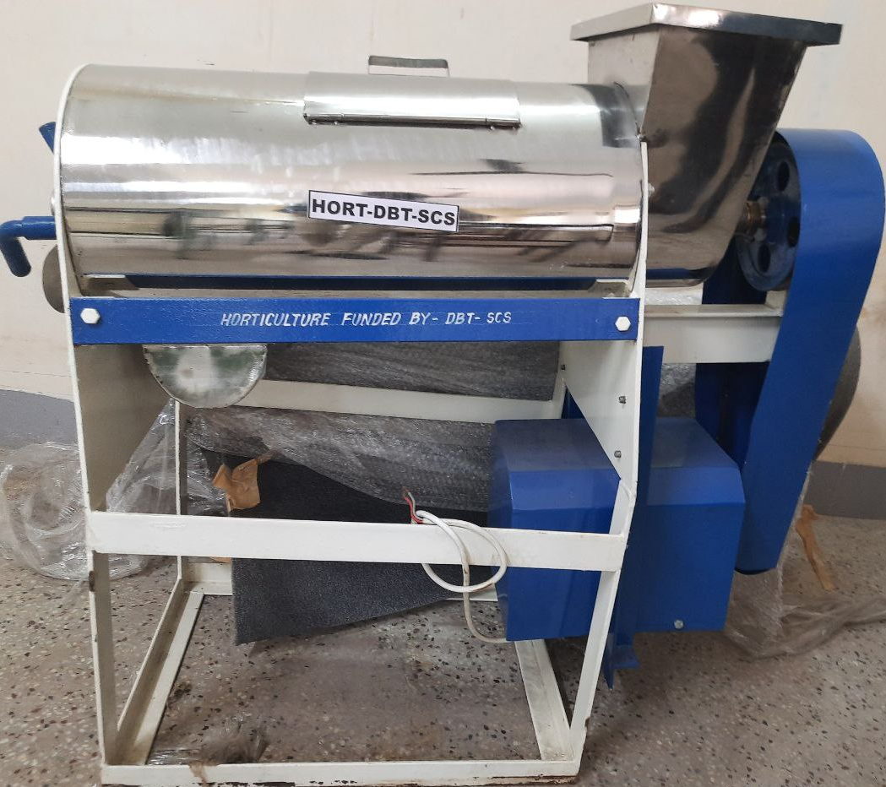
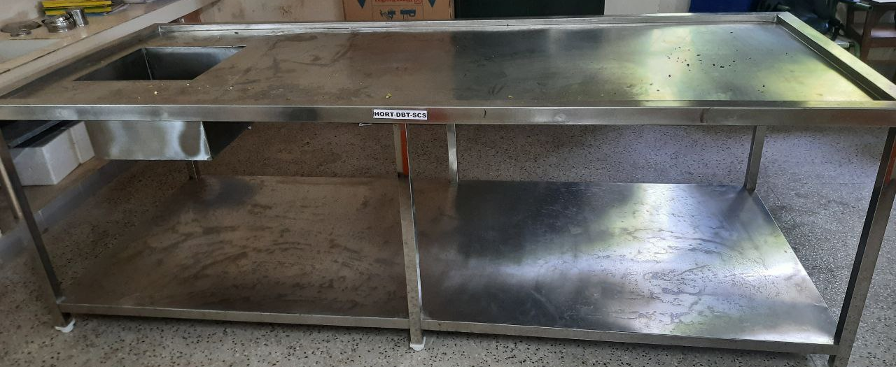
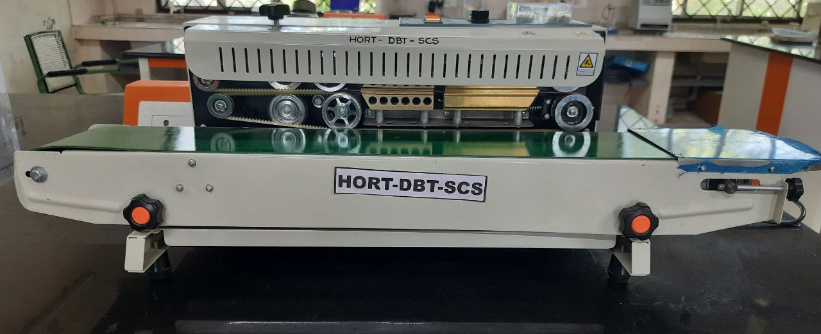
B. Equipment’s procured for proposed practical – non recurring CONTIGENCY
HOT AIR OVEN Rs.79,905/-
CABINET TRAY DRIER Rs.94,962/-
FRUIT PULPER Rs.87,360/-
WORK TABLE WITH STAINLESS STEEL TOP-Rs.99,710/-
CONTINUOUS BAND SEALING MACHINE – Rs.39,900/-

Slide 6
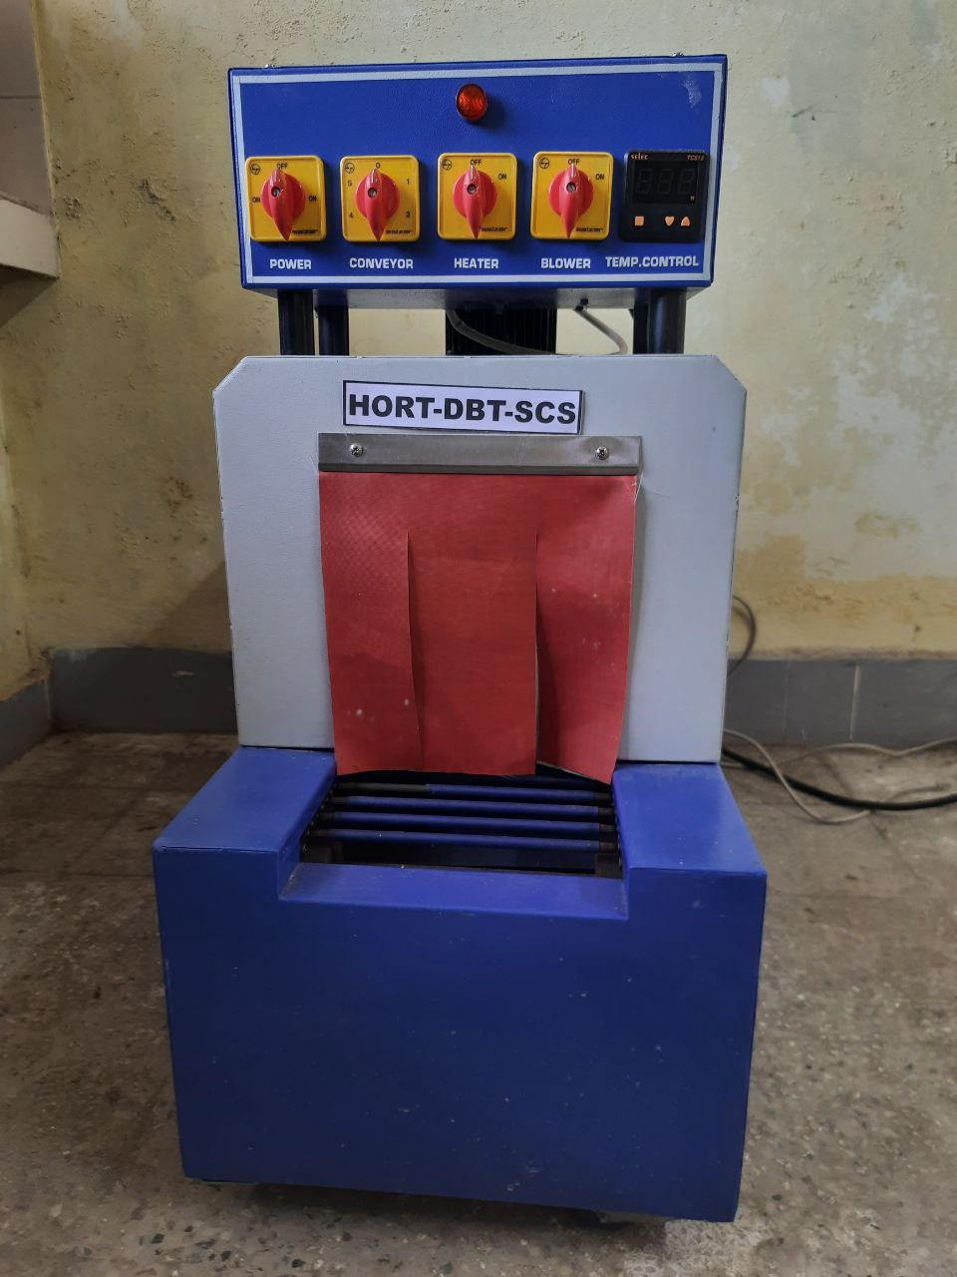
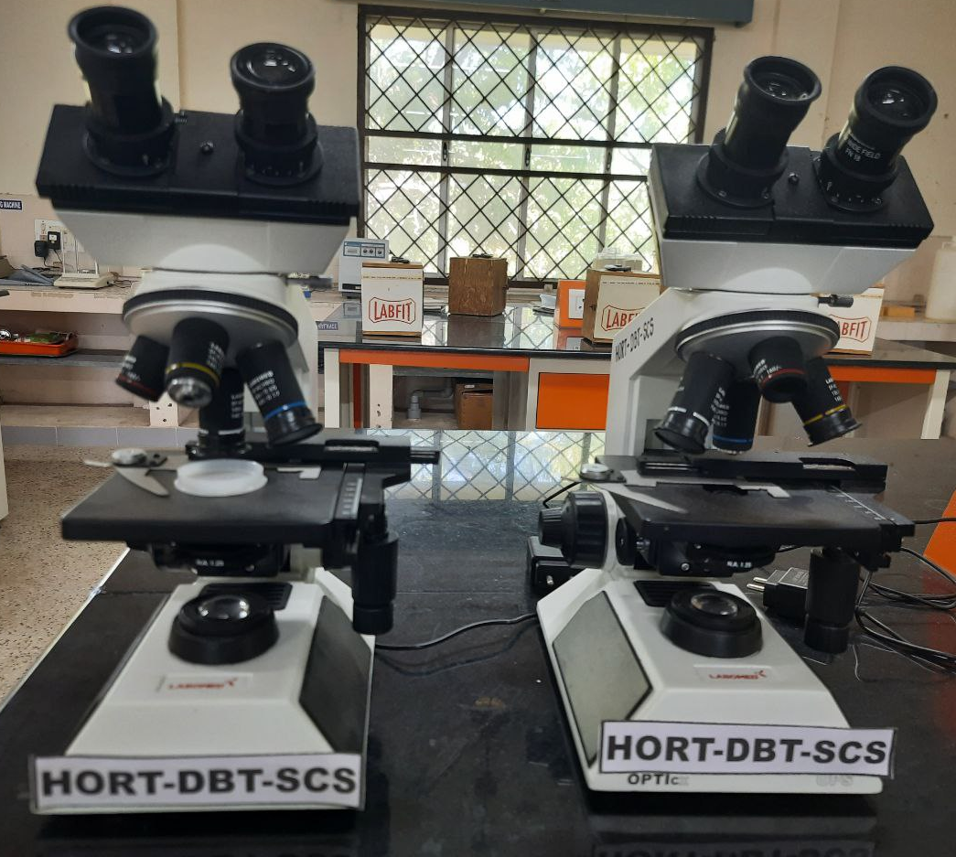
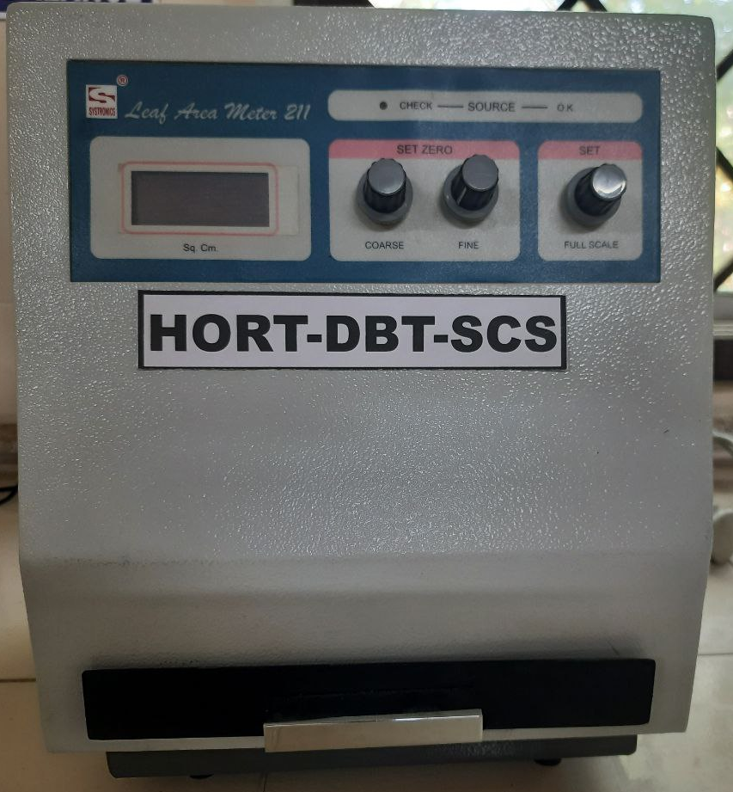
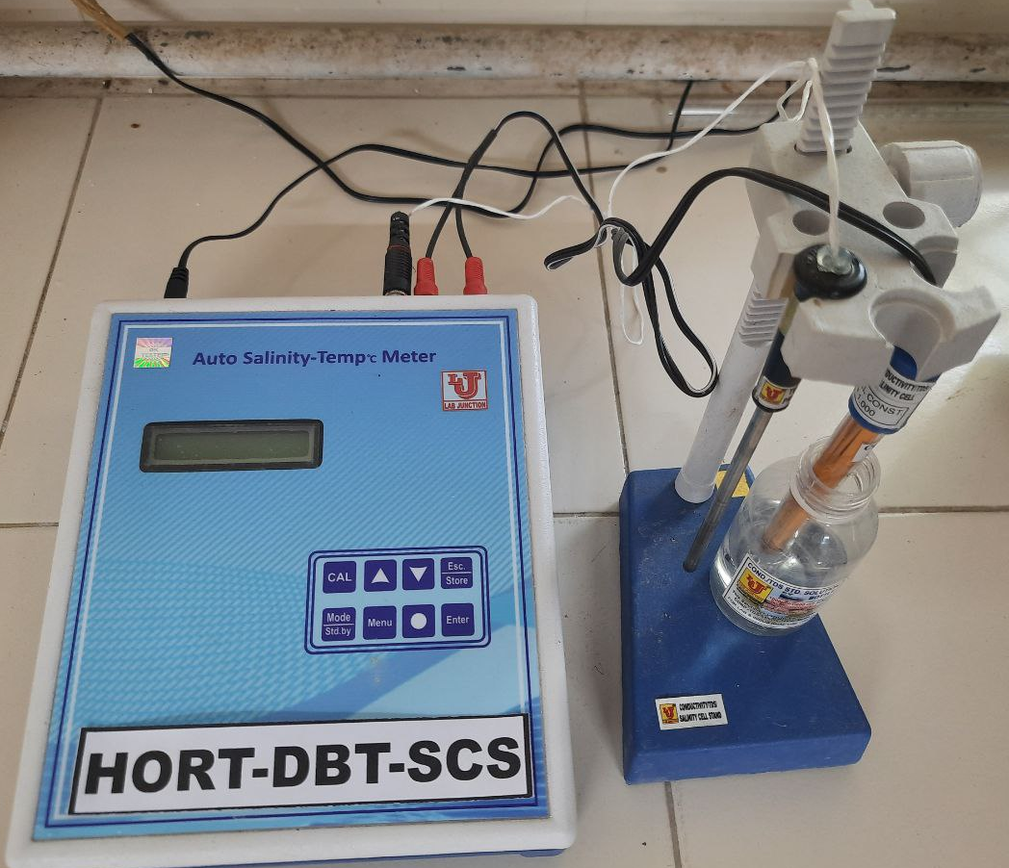
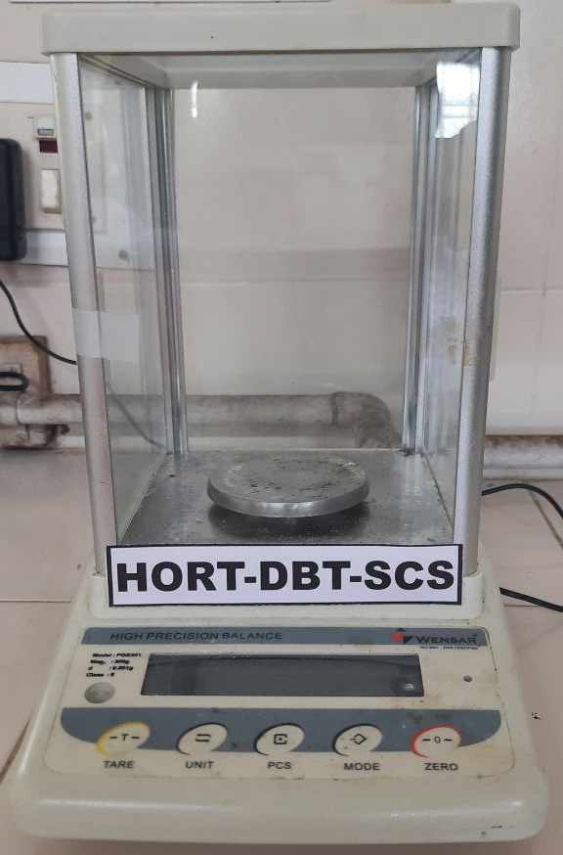
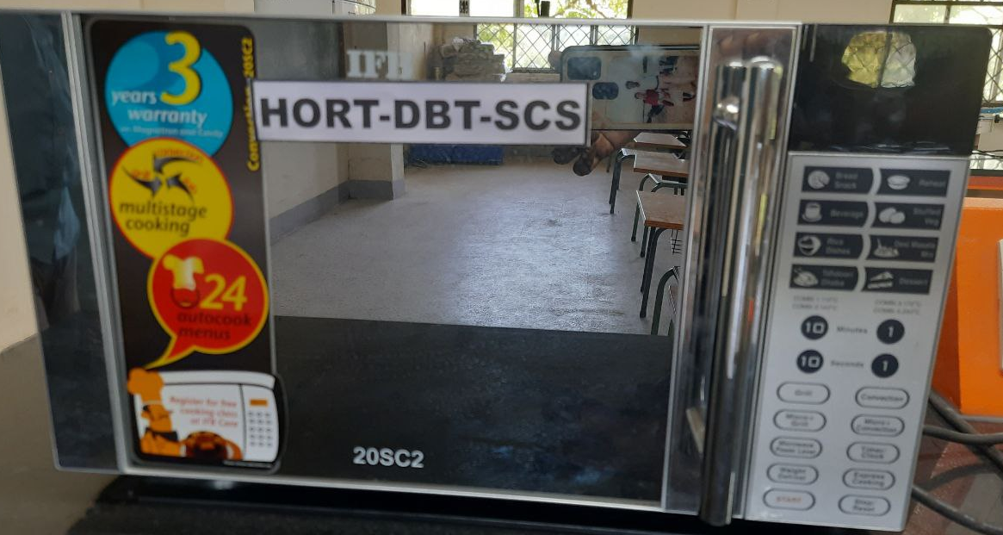
SHRINK WRAPPING MACHINE – Rs.74,970/-
COMPOUND MICROSCOPE –Rs.69,930/-
LEAF AREA METER-Rs.99,002/-
BRINE METER- Rs.14,910/-
WEIGHING BALANCE-Rs.59,850/-
MICROWAVE OVEN-Rs.16,905/-

Slide 7
b. NEW PRACTICAL CONDUCTED BY USING EQUIPMENTS PURCHASED UNDER DBT-SCS
NAME OF THE COURSE | TITLE OF THE PRACTICAL
PHT 201 Fundamentals of food technology (1+1) | Preparation of jam, jelly, marmalads and fruit beverages (RTS, Nectar, cordial & fruit syrub) – Fruit pulper Dehydration and osmotic dehydration of fruits (sapota, mango, banana, jack, karonda, aonla) and vegetables (moringa, brinjal, tomato, green chilli and beans) - cabinet tray dryer Preparation of banana based baby food (powder) – Cabinet tray dryer For conducting the storage studies on fruits and vegetables and their products – Deep freezer. For measuring the firmness in fruits and veg. and the internal pressure in canned processed food – Pressure tester For conducting packaging experiments in fruits and vegetables - shrink wrapping machine Preparation of tomato juice (RTS, Sauce) – Tomato juice extractor Sealing of beverage glass bottle - Crown corking machine Blanching , drying, pasteurization of fruit and vegetables – Microwave oven
2. PHT 302 Post harvest management of horticultural crops (2+1) | 1. Different packaging methods for fruits and vegetable -
3. PHT 303 Processing of horticultural crops (1+2) 4. FSN 301Pricnciples of food science and nutrition (2+0) | Preparation of jam, jelly, marmalads and fruit beverages (RTS, Nectar, cordial & fruit syrub) – Fruit pulper Preparation of banana based baby food (powder) – Cabinet tray dryer Dehydration and osmotic dehydration of fruits (sapota, mango, banana, jack, caronda, aonla) and vegetables (moringa, brinjal, tomato, green chilli, turkey berry, beans) - cabinet tray dryer To conduct the storage studies on fruits and vegetables and their products – Deep freezer. To measure the internal pressure in canned processed food – Pressure tester Used to seal the product in polybag in air tight - continuous band sealing machine Preparation of tomato juice (RTS, Sauce) – tomato juice extractor Sealing of beverage glass bottle by using crown corking machine
5. HOR 301Growth and development of horticultural crops (2+1) | For working out the leaf area index and photosynthetic efficiency in horticultural crops – Leaf area meter For measuring the biometrical observations - Vernier caliper

Slide 8
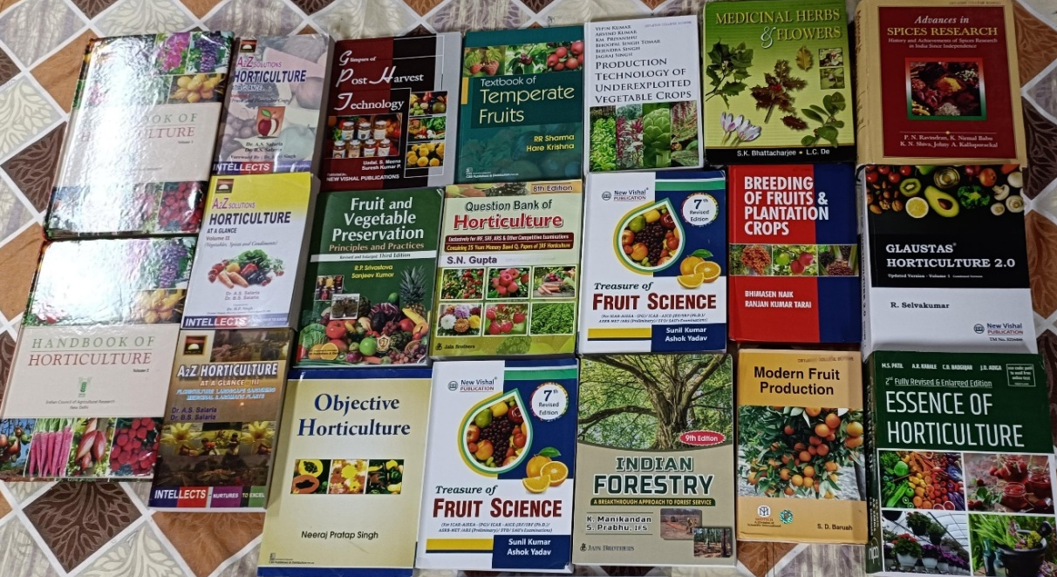
Books purchased under DBT-SCS
Sl No. | Name of the Books | Authors Name | Rate (Rs.)
1. | Modern Fruit Production | S.D. Barvah | 1395
2. | Medicinal Herbs and Flowers | S.K. Bhattacharjiee, L.C. De | 2000
3. | Production Technology of Under exploited vegetable crops | Vipin Kumar et al., | 3600
4. | Text book of temperate fruits | R.R. Sharma Hara Krishna | 295
5. | Question Bank of Horticulture | S.N. Gupta | 350
6. | Objective Horticulture | Neeraj Pratap Singh | 495
7. | Breeding of Fruit and Plantation Crops | Bhinasen Naik | 2995
8. | Glaustas Horticulture | Dr. P. Muthukumar & R. Selvakumar | 1195
9. | Indian Forestry | K. Manikandan and S. Prabhu | 625
10. | Advances in Spice Research | P. N. Ravindran | 4500
11. | A2Z Solutions Horticulture at a Glace (Vol-I,II,III) | Dr. A.S. Salaria and Dr. B.S. Salaria | 1485
12. | Green House management of Horticulture Crops | Sandhya Sharif | 2195
13. | Essence of Horticulture | M.S. Patel | 895
14. | Treasure of Fruit Science | Sonil Kumar and Ashok Yadav | 650
15. | Glimpses of Post Harvest Technology | Udal Sing Meena | 310
16. | Treasures of fruit science | Ashok yadav | 650
17. | Post harvest management and processing of vegetables | N S Rathore, G.K.Madhur, SS Chasta | 350
18. | Frutis and vegetable preservation: Principles and practices | Srivastava | 795
 | Total | 24,780

Slide 9
a. New or additional practical's introduced by the Dept. of Horticulture

Slide 10
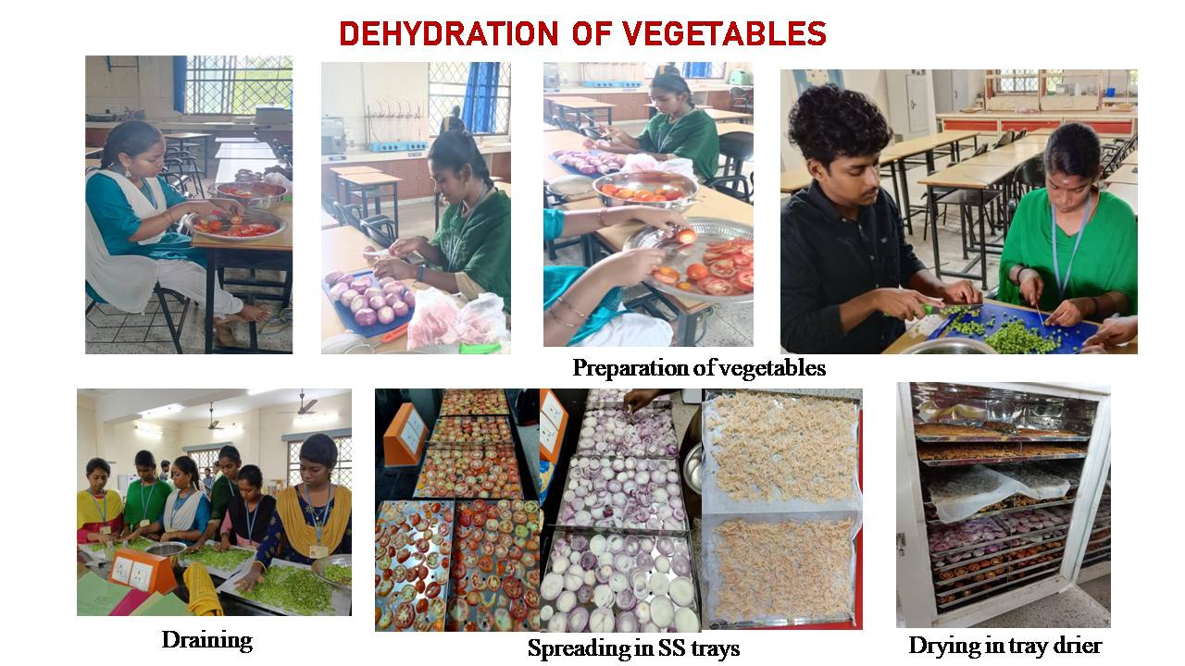

Slide 11
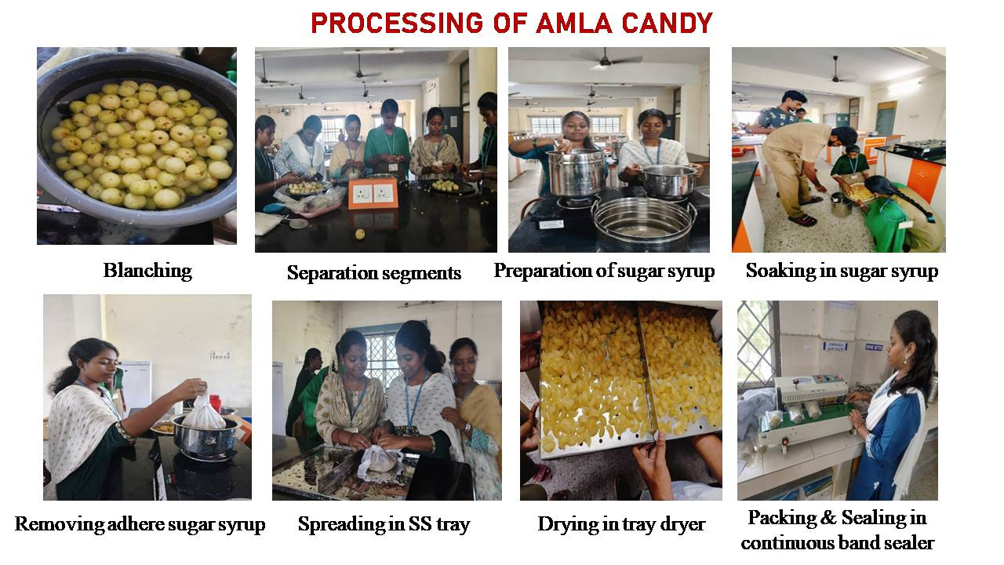

Slide 12
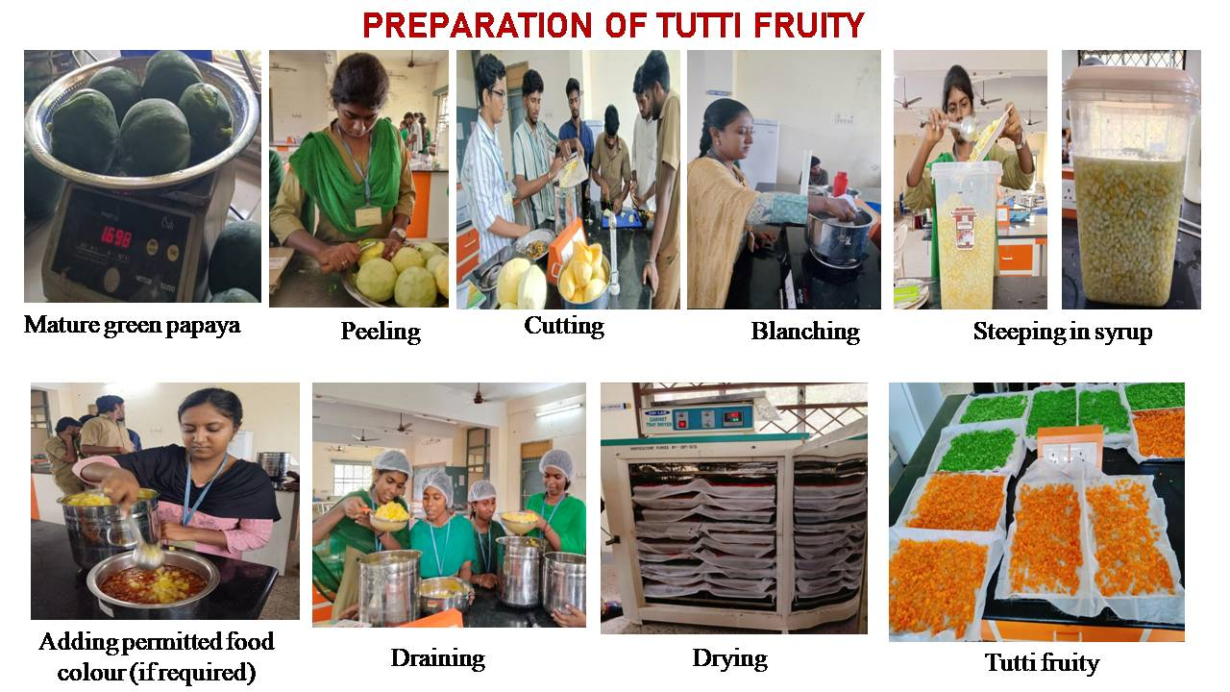

Slide 13
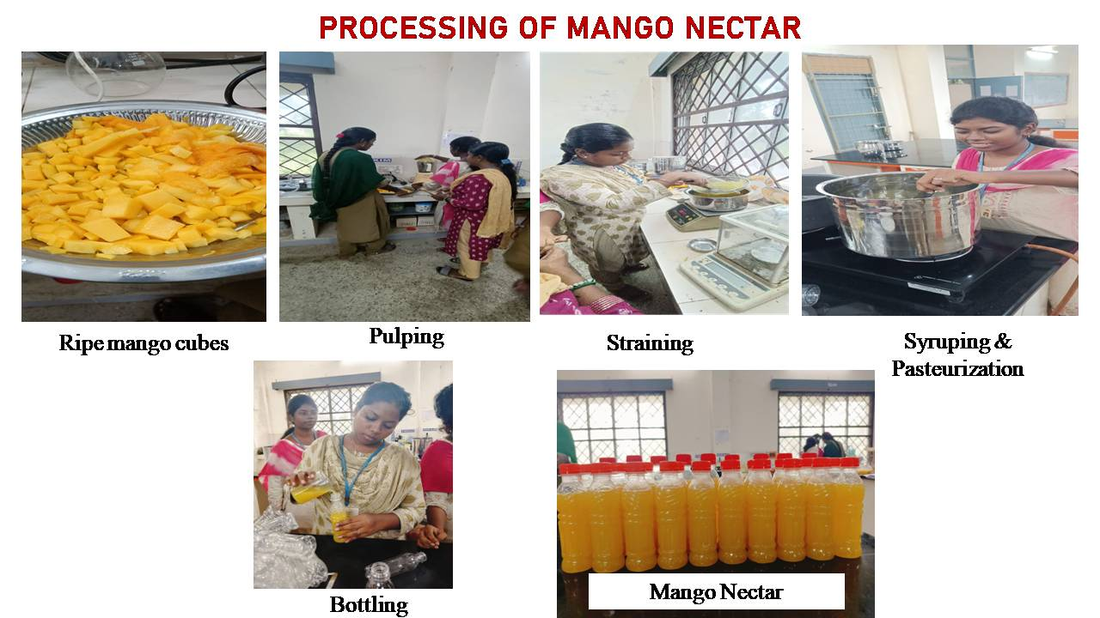
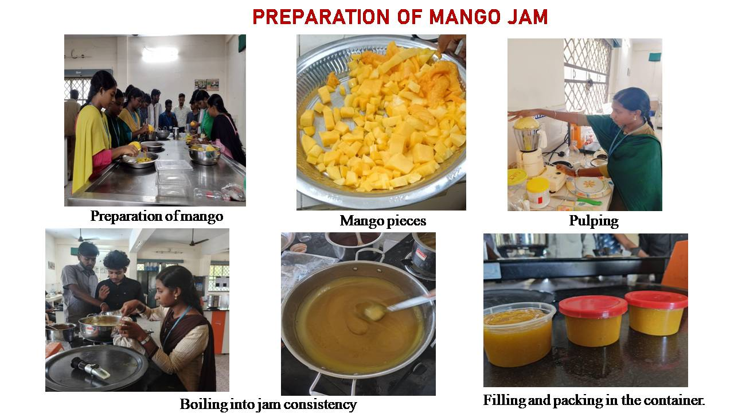

Slide 14
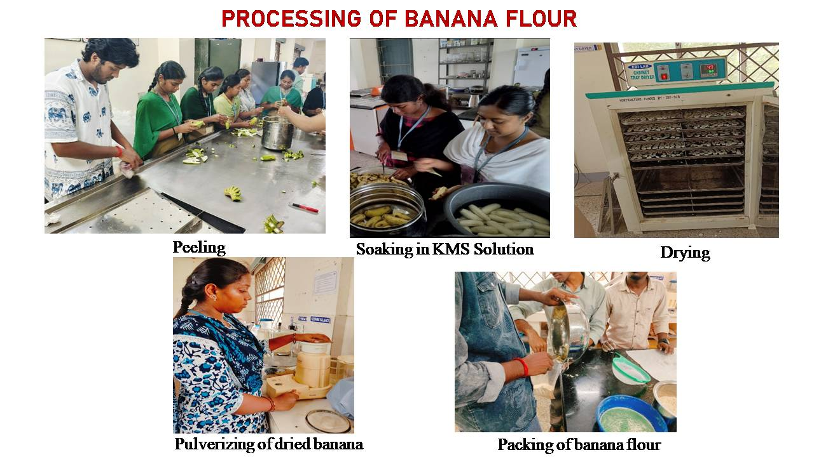

Slide 15
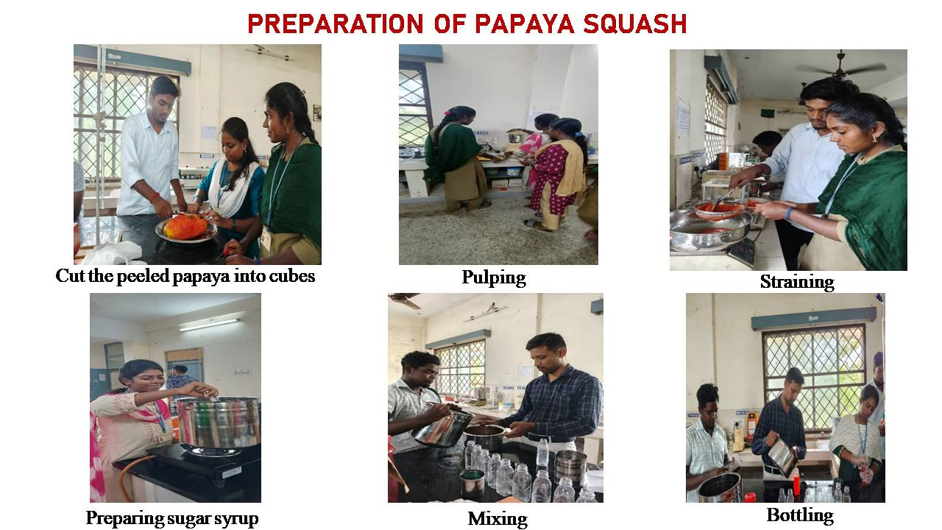
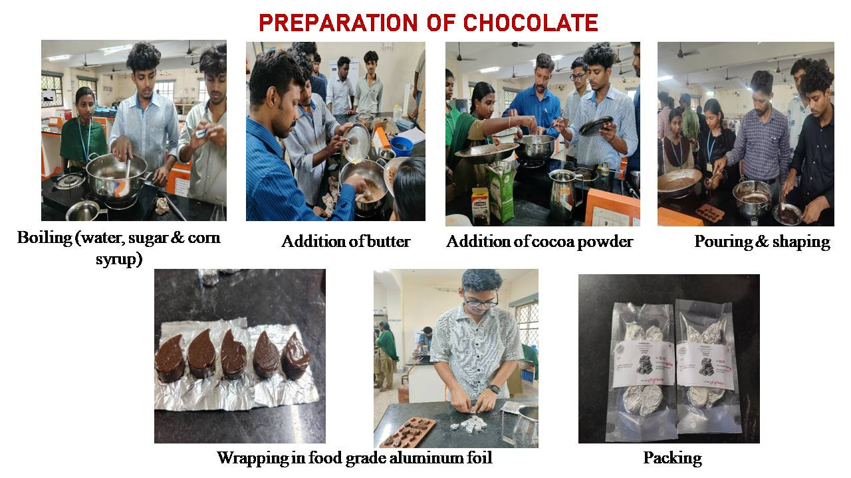
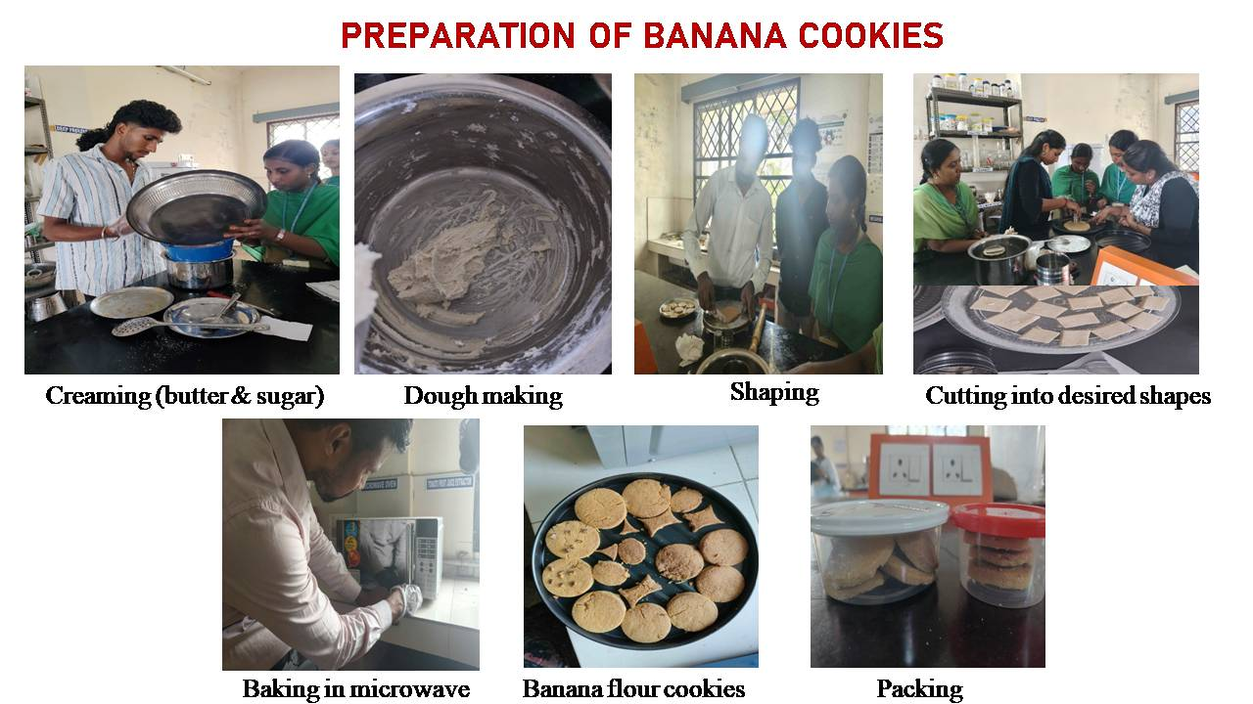

Slide 16
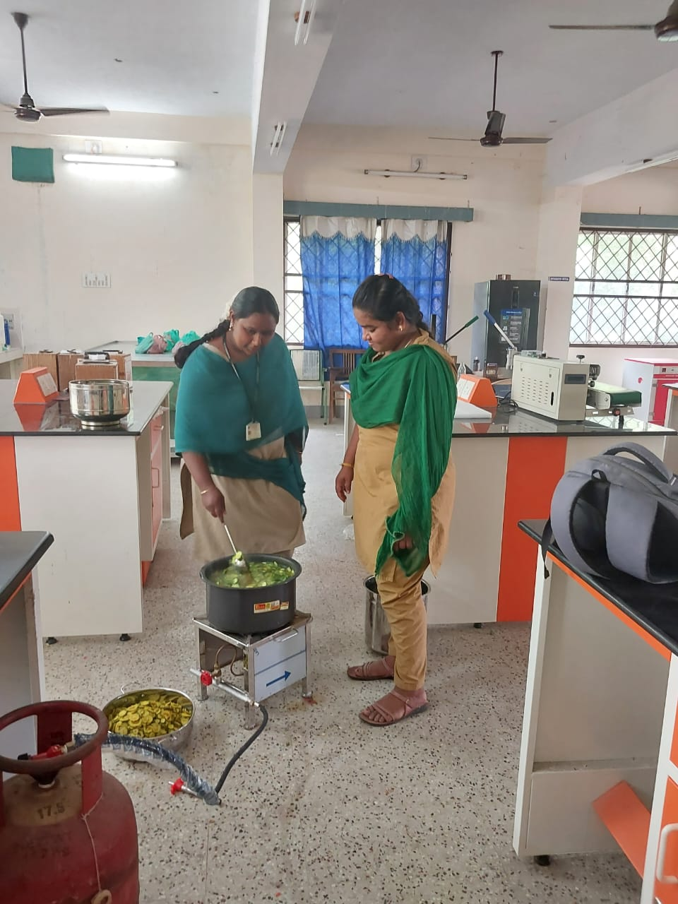
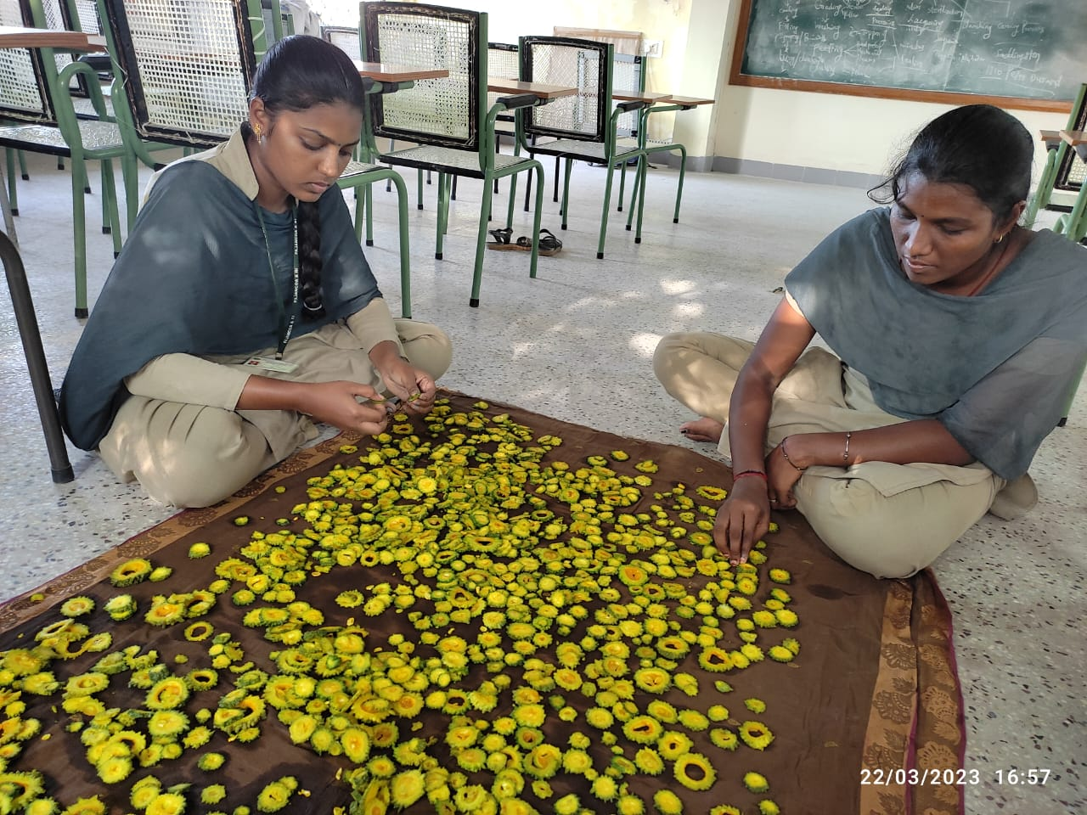
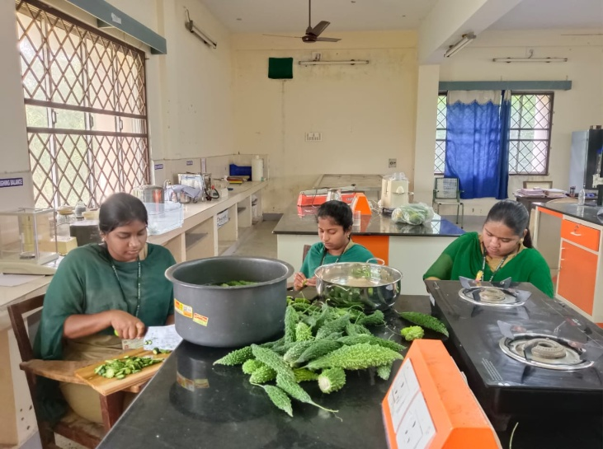
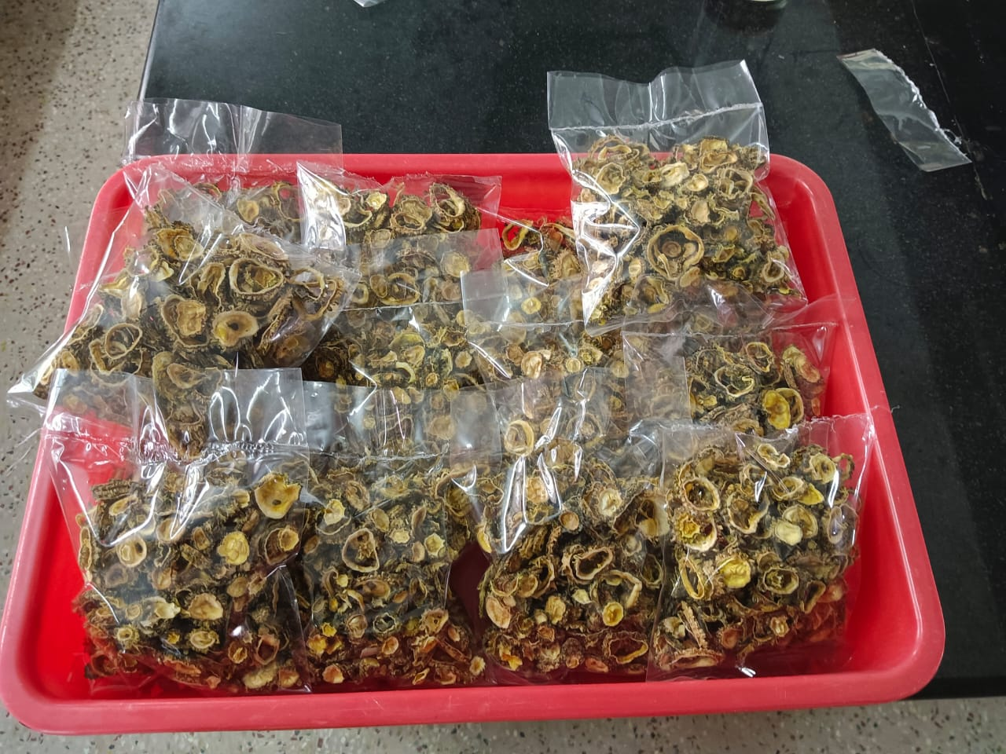
HANDS-ON TRAINING on PREPARATION OF DEHYDRATED BITTER GOURD

Slide 17
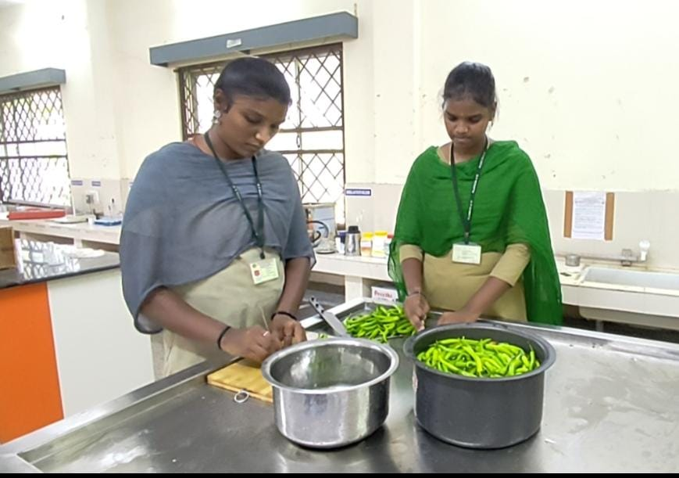
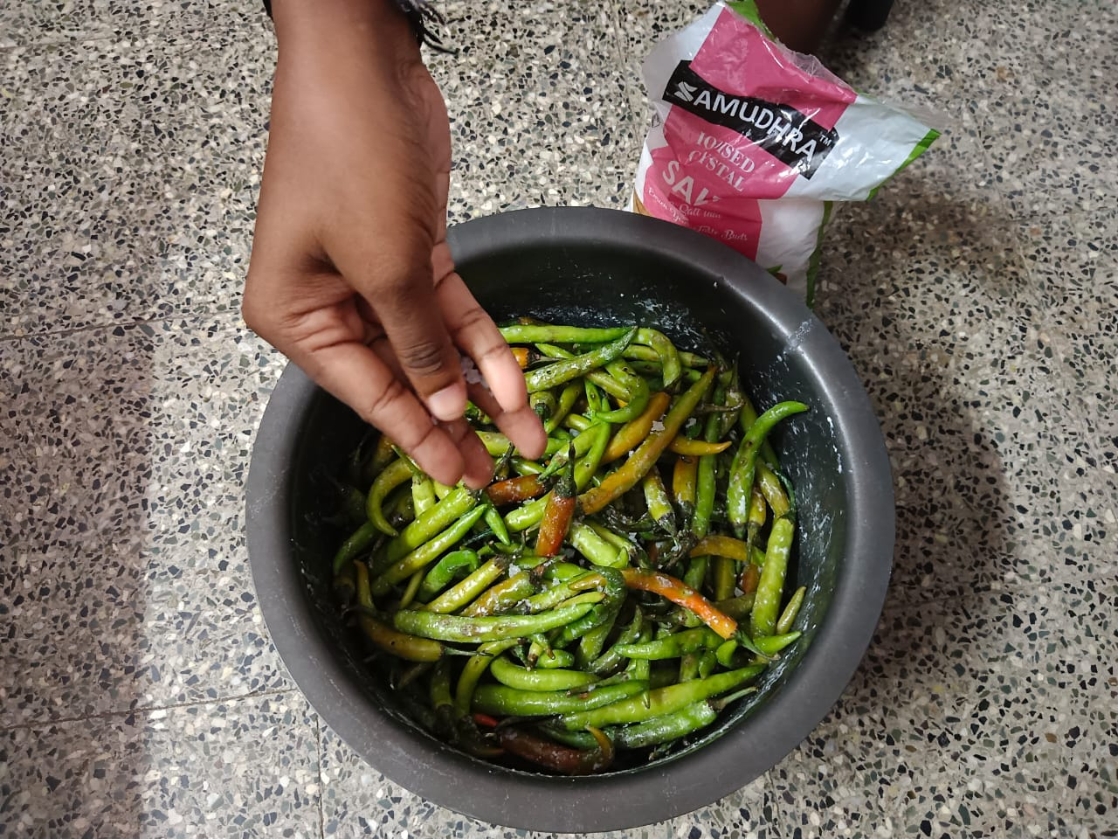
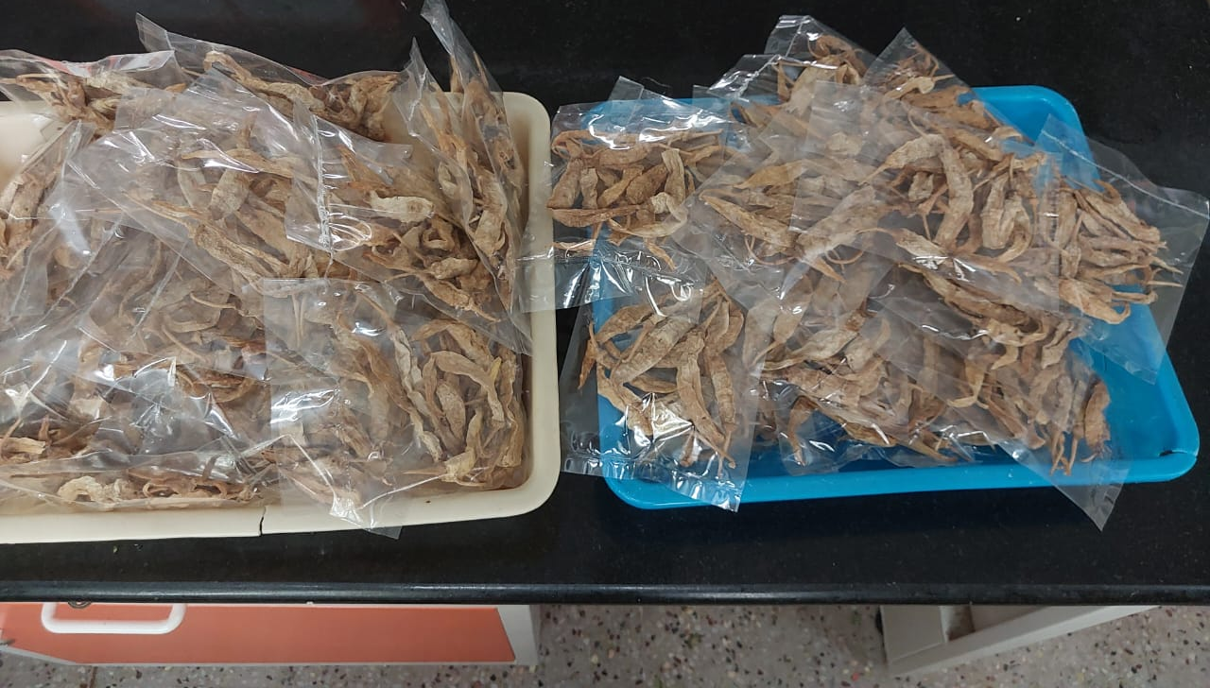
HANDS-ON TRAINING ABOUT PREPARATION OF DEHYDRATED CHILLI

Slide 18
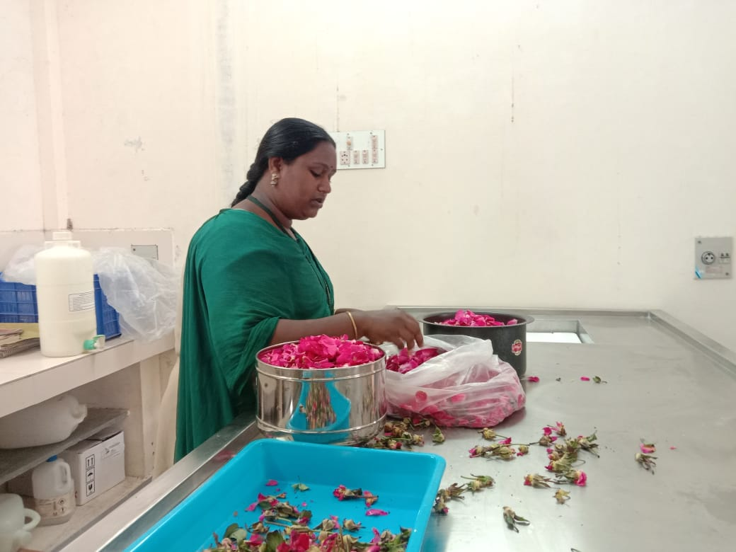
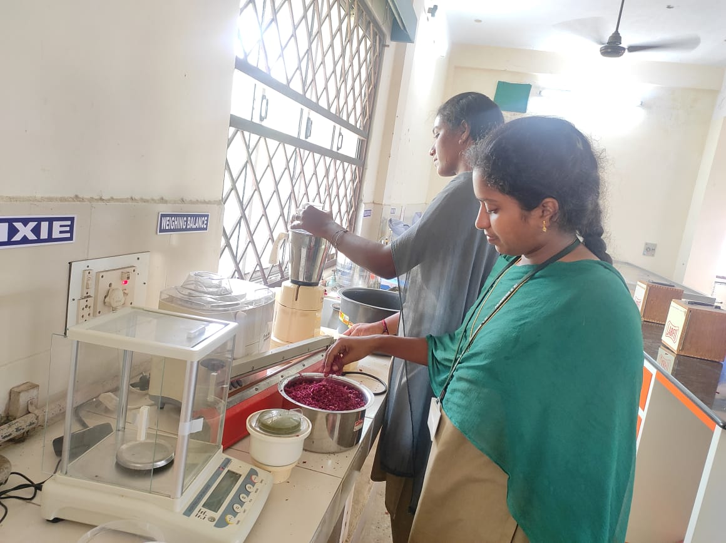
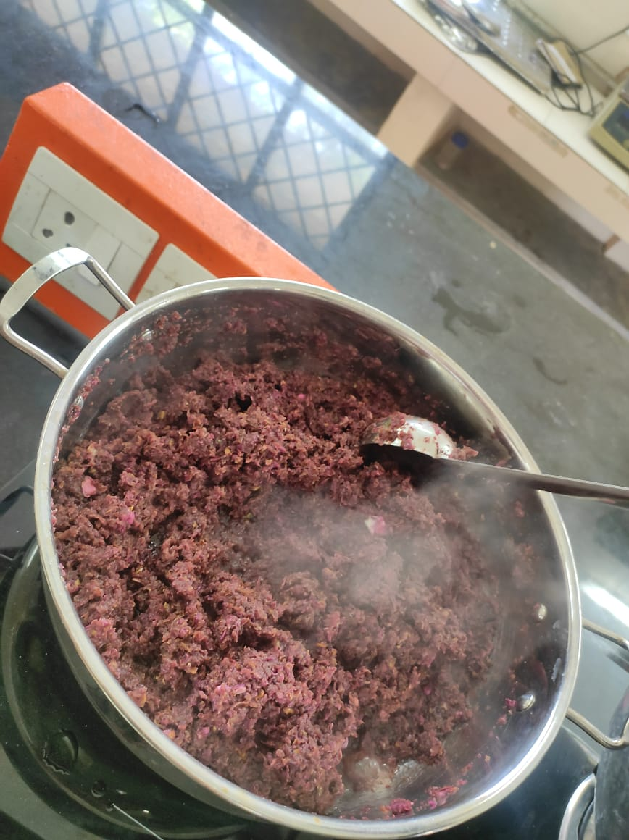
HANDS-ON TRAINING on PREPARATION OF rose GULKAND

Slide 19
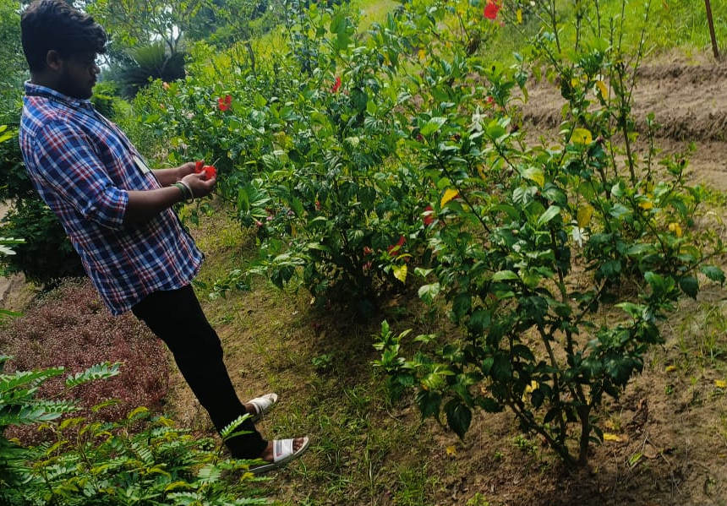
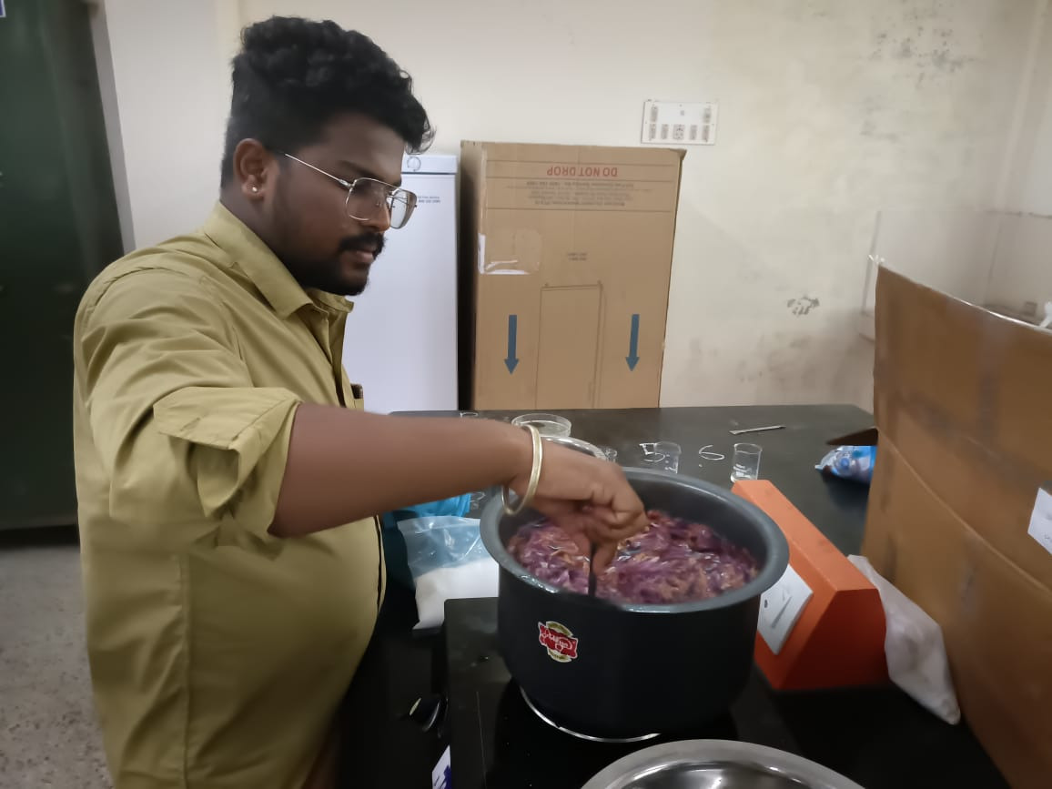
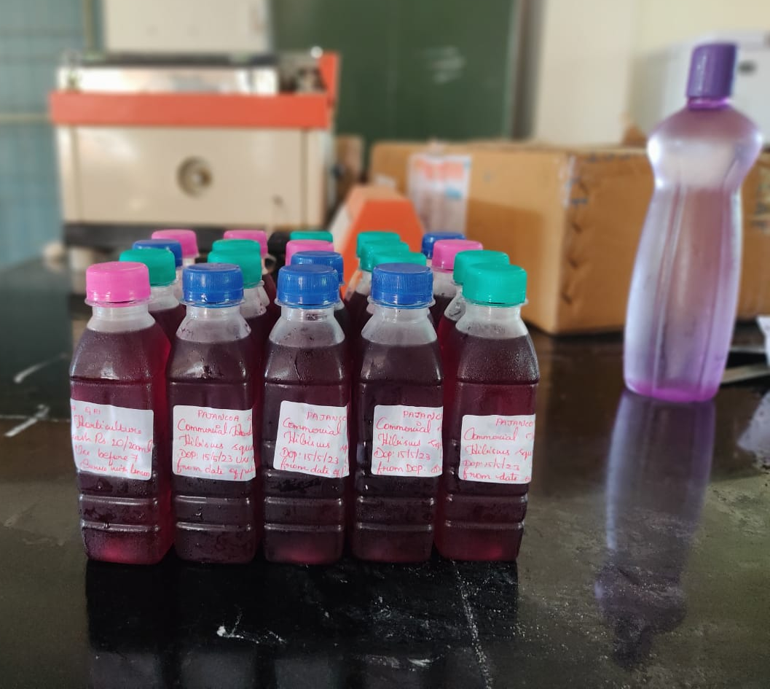
HANDS-ON TRAINING ABOUT PREPARATION OF HIBISCUS SQUASH

Slide 20
c. Interdisciplinary/interdepartmental projects executed by the students
NAME OF THE COURSE | TITLE OF THE PROJECTS | DEPARTMENTS INVOLVED
ELP 408 Commercial Horticulture (0+10) | Standardization of rooting in cuttings of guava | Horticulture & Plant Physiology
 | Standardization of rooting in cuttings of Acalypha wilkisiana
 | Standardization of rooting in cuttings ficus panda

Slide 21
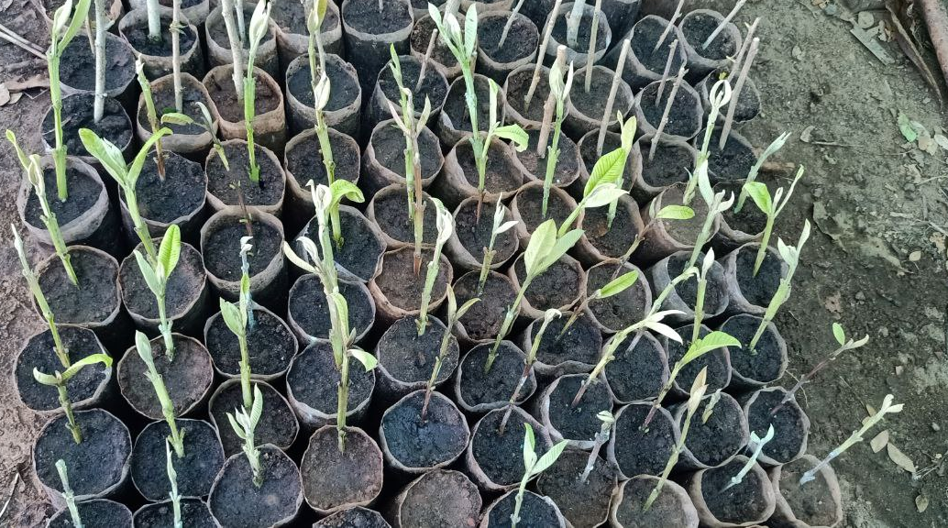
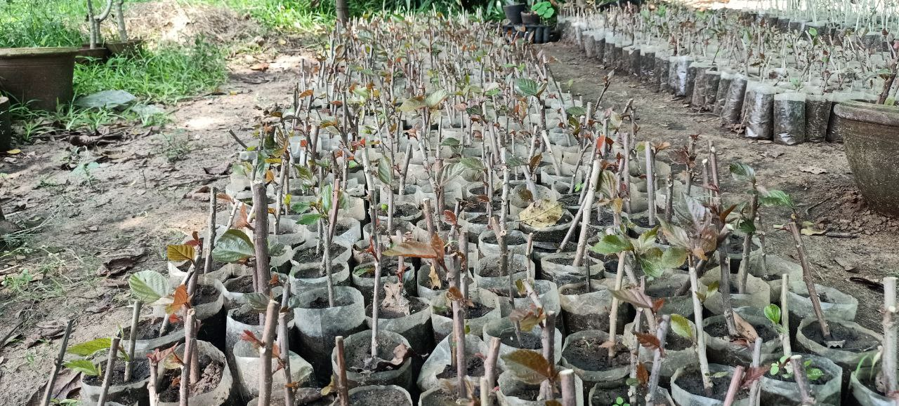
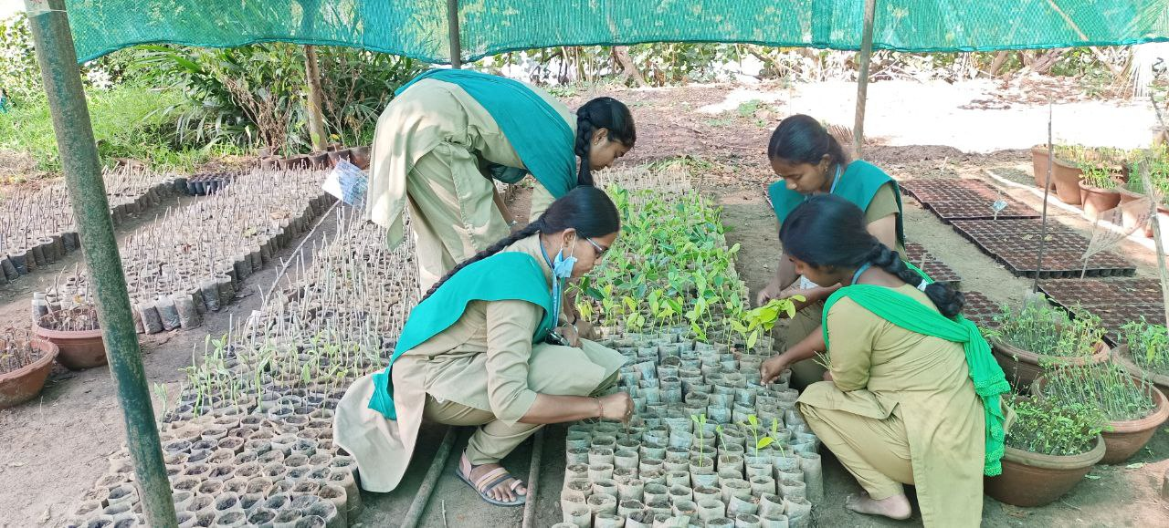
Standardization of rooting in cuttings of Guava
Guava – semi hardwood cutting + IBA 1000 ppm
Acalypha wilkisiana – hardwood cutting + IBA 1000 ppm
Ficus panda – Herbaceous cutting + IBA 500 ppm

Slide 22
D. Workshops and seminar organized in topical areas for students by the Departments

Slide 23
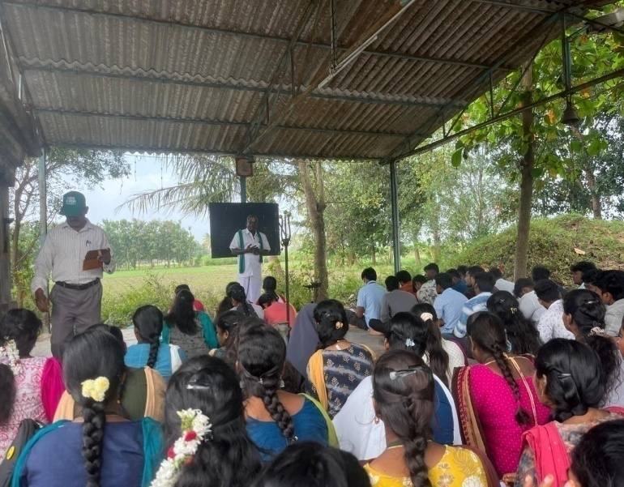
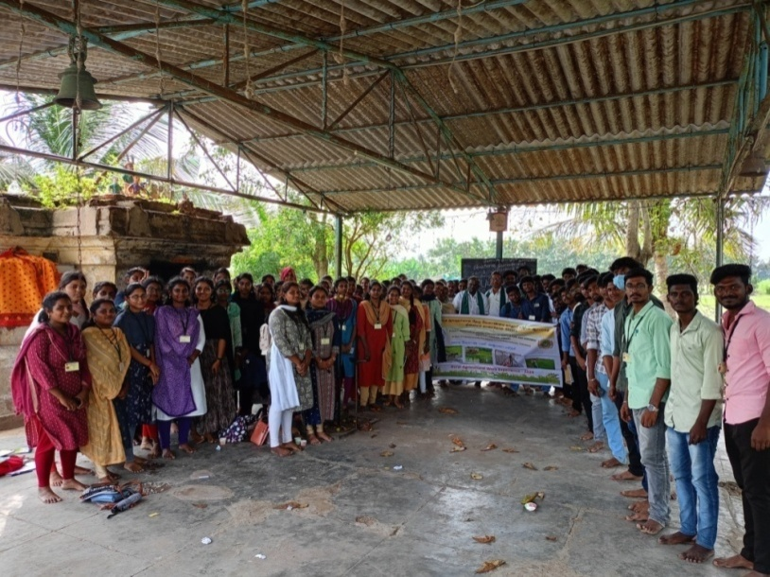
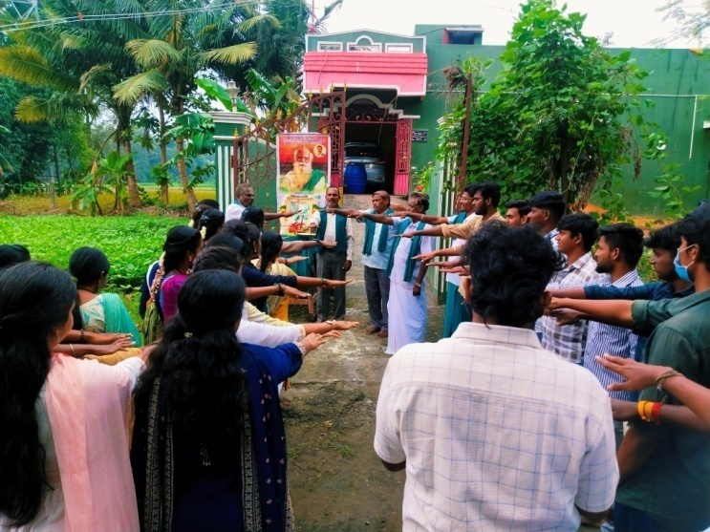
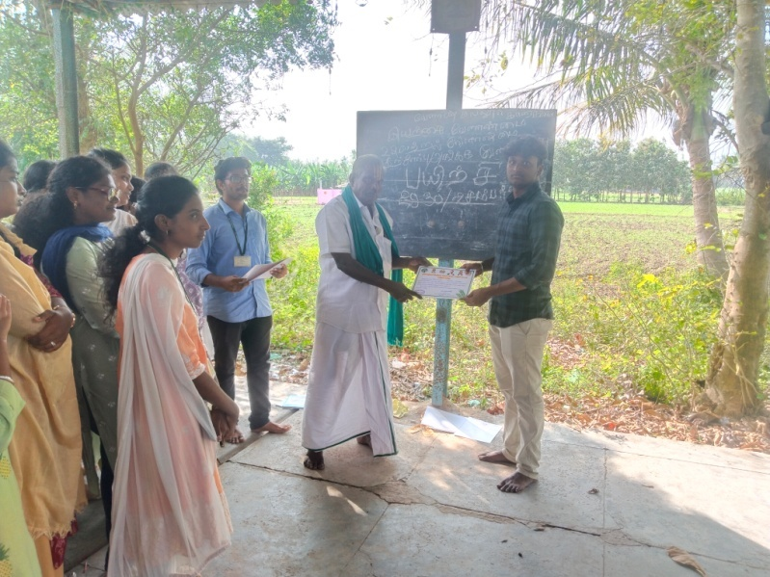
Two-days training on Organic Farming
by R. Veenugopal, Union Leader of Nammalvar Iyayrkai Velanmai Sangam, in Purana Singa Palayam, Pondicherry on December 29-30, 2024

Slide 24
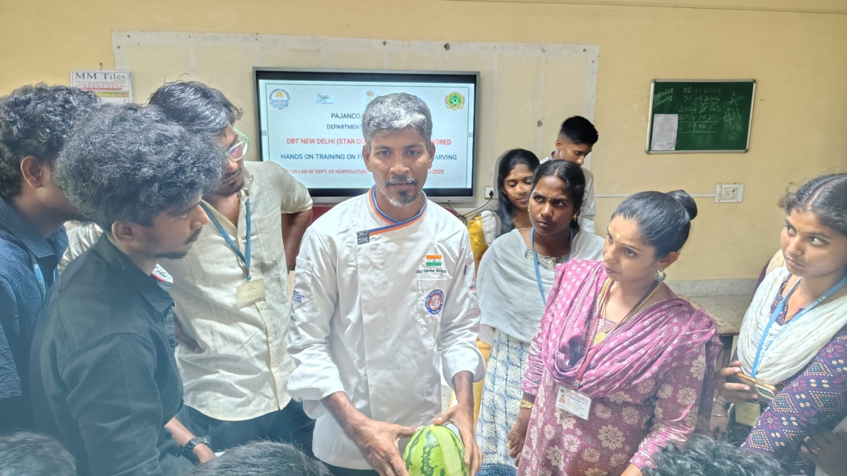
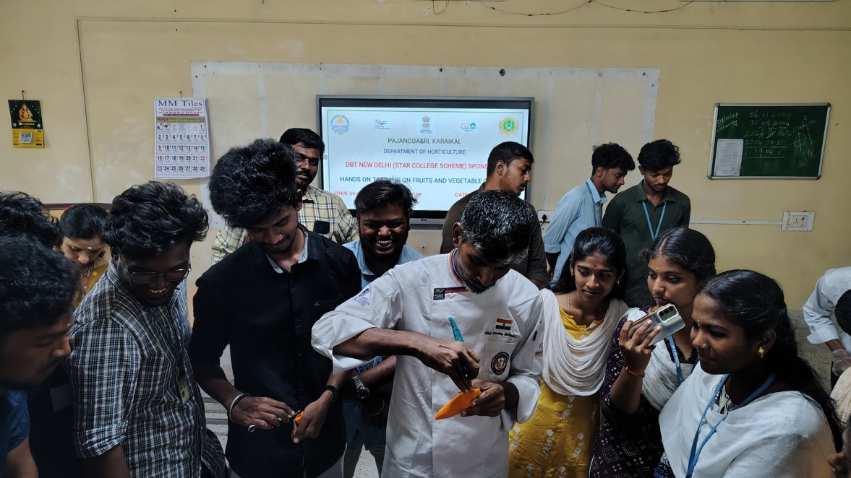
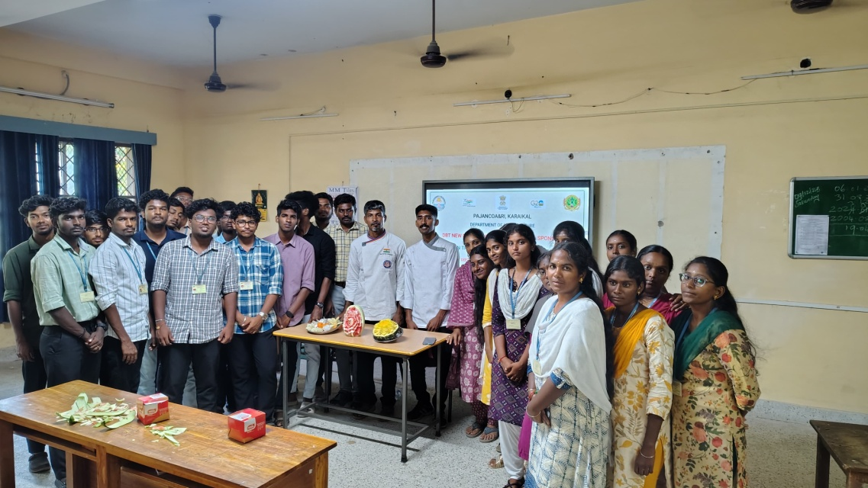
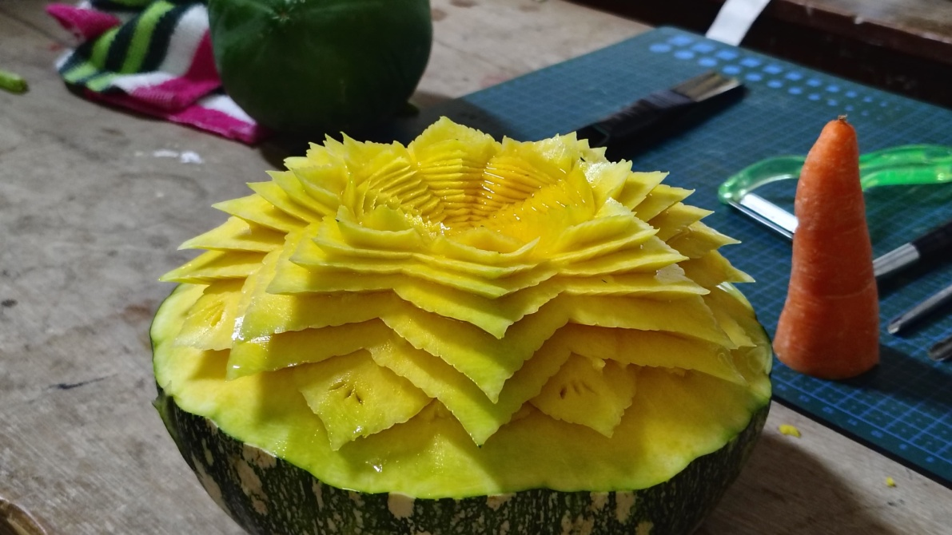
Workshop on “Fruits and Vegetable carving to the IV B.Sc. (Hons.) Horti. Students on 29.03.2025

Slide 25
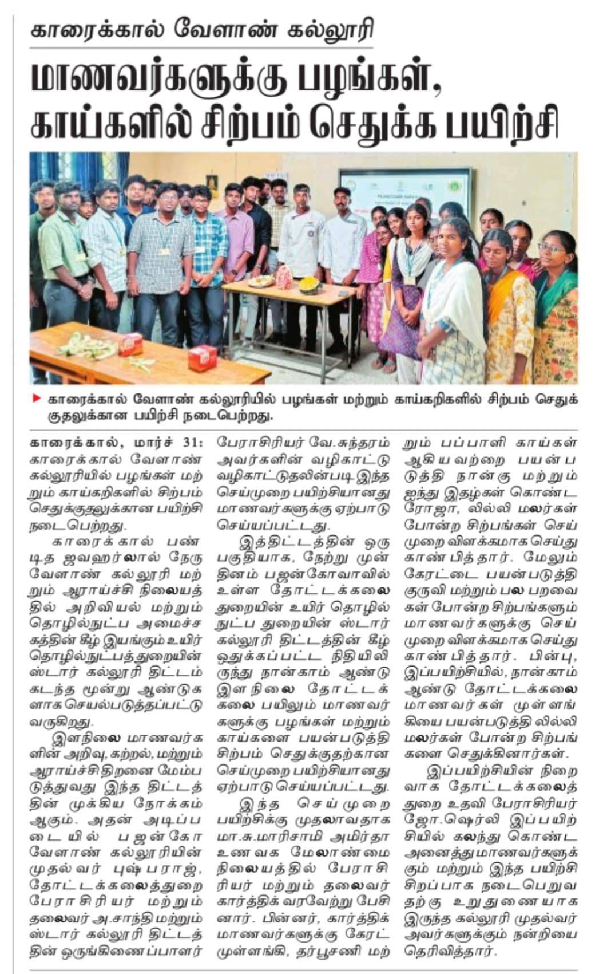
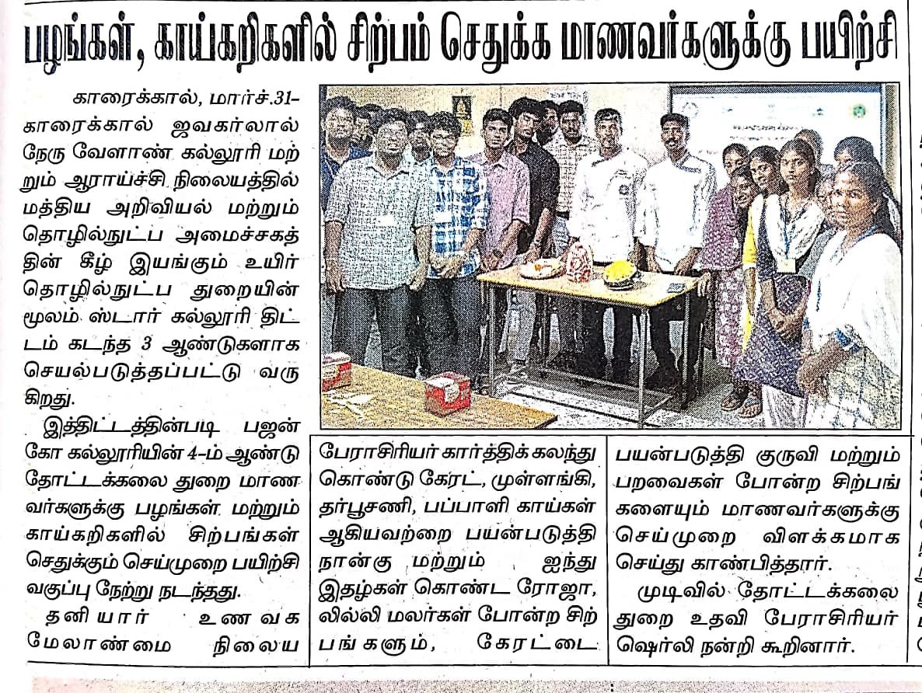
WORKSHOP ON “FRUITS AND VEGETABLE CARVING PUBLISHED IN DINATHANTHI AND DHINAKARAN ON 31.03.2025
DHINAKARAN – KARAIKAL - 31.03.2025
DINATHANTHI , KARAIKAL - 31.03.2025

Slide 26
E. FACULTY IMPROVMENT PROGRAMS INITIATED FOR THE FACULTY

Slide 27
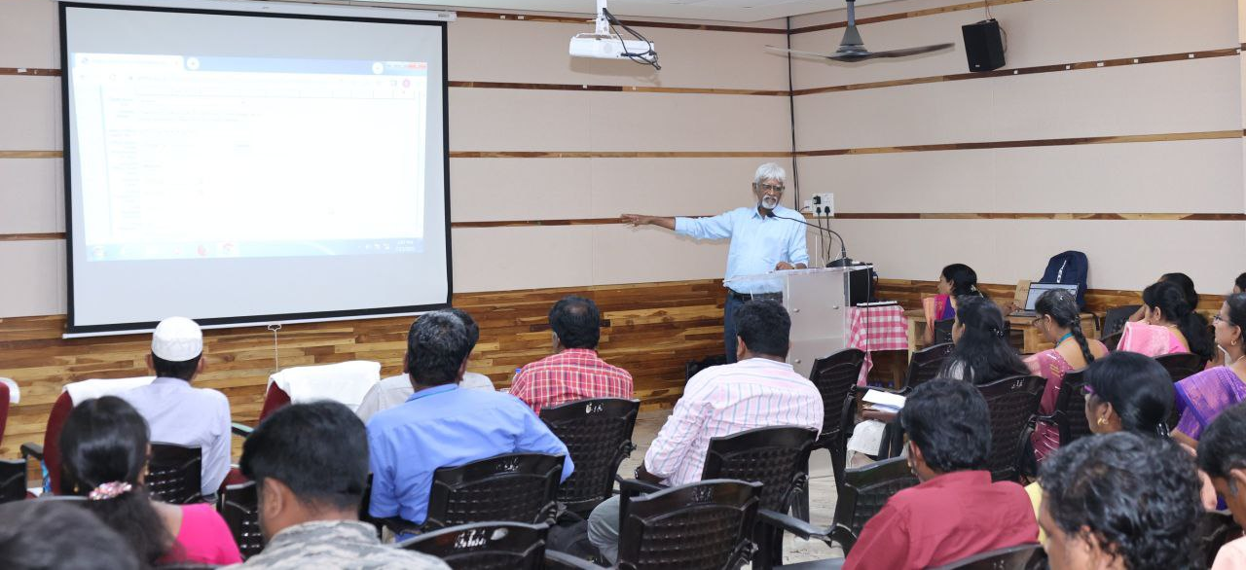
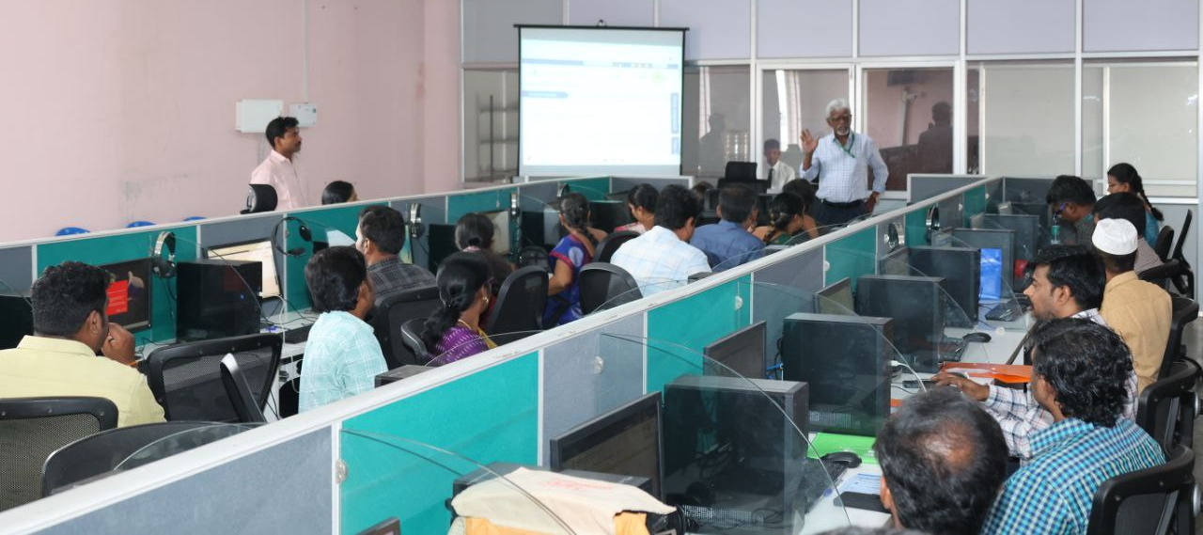
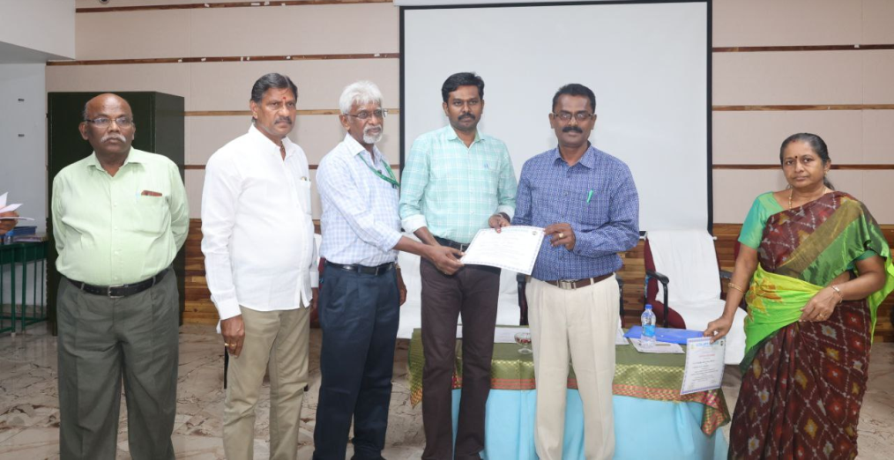


1. Attended PFMS Training at GTN Arts College, Dindigul on 15th & 16th July 2025
2. Attended an International Conference on Precision Horticulture at HC&RI, Periyakulam from
22.8.24 to 24.08.24 by Dr.V.Sundaram, Prof. (Hort.) cum Co-ordinator DBT-SCS

Slide 28
F. VISIT TO INDUSTRY AND IMPORTANT LABS

Slide 29


Annapoorna organic manure production unit, Karikalpalayam Farm, Bengaluru on 28.05.22

Slide 30



Multiplex Drones Pvt.Ltd., Vijaya Nagar, Bengaluru on 29.05.22

Slide 31



Indo American Hybrid Seeds Private Ltd, Bengaluru on 30.05.22

Slide 32

SEMIO-CHEMICAL LABORATORY OF GPS INSTITUTE OF AGRICULTURE & MANAGEMENT, PEENYA, BENGALURU 01.06.22

Slide 33



Gamma rays chamber at IIHR, Bangalore 02.06.22

Slide 34


PAVITHRAN MANGO PULPING UNIT, PAIYUR, KRISHNAGIRI ON 07.06.22

Slide 35



EXPOSURE VISIT- Seedling production and Protected Cultivation of Pirandai at TNAU, Coimbatore on 12.05.2022

Slide 36



Practical Exposure - Vertical Gardening at TNAU on 12.05.22

Slide 37


Exposure visit to Karnataka Siri Horticulture Garden and vegetable market, Ooty

Slide 38
G. Lectures Delivered by Experts/Speakers in the relevant subject area

Slide 39



Guest Lecture on Canopy Management in Fruit Crops
by Dr.R. Senthilkumar, Principal Scientist, ICAR - IIHR, Bengaluru (29.01.2024)

Slide 40




Guest Lecture on “Advance production and postharvest technology and value addition for higher profitability in Banana”
Dr. V. Kumar, Principal Scientist, ICAR- NRCB, Trichy (31.01.2024)

Slide 41

Guest lecture on ICAR- IISR Spicing up nation's progress by Dr.V. Srinivasan, Principal Scientist & Head, Division of crop production and post harvest technology on 27.03.24

Slide 42


Guest lecture on “Enhanced postharvest in fruits using hexanal based nanotechnology”
Dr. Jayasankar subramanian, Professor, Tree Fruit Breeding and Biotechnology,
University of Guelph-vineland Campus, Canada on 28.02.2025

Slide 43
H. OUTREACH ACTIVITIES

Slide 44




DEMONSTRATION ON LOW TUNNEL STRUCTURE

Slide 45






DEMONSTRATION ON MACROPROPAGATION IN BANANA

Slide 46




DEMONSTRATION ON PROTRAY NURSERY

Slide 47

Demonstration of cultivation of vegetables under low tunnel structures, production of hybrid vegetable seedlings under portray nursery, macro propagation, paring and pralinage in banana to the farmers of Vannur, Villupuram district on 11.12.2024

Slide 48





Demonstration of horticultural technologies to the farmers of Nimmeli village of
Puducherry on 10.01.2025

Slide 49


Demonstration of horticultural technologies to the farmers of Nimmeli village of Puducherry on 10.01.2025
MALAI MURASU, PUDUCHERRY - 11.01.2024
KARAIKAL ONLINE - 13.01.2025

Slide 50






Demonstration on multitier system of cropping in coconut, importance of mulching, ZECC, drip irrigation and its uses to the farmers of Karayamputhur, Pondicherry on 10.01.2025

Slide 51

Demonstration on multitier system of cropping in coconut, importance of mulching, ZECC, drip irrigation and its uses to the farmers of Karayamputhur, Pondicherry on 10.01.2025
DINAMALAR , PUDUCHERRY- 13.12.2024

Slide 52




Demonstration of various technologies on organic farming, roof gardening, importance of mulching and nano urea and also disease management in guava to the farmers of Matam village in Vandavasi block of Thiruvannamalai district on 26.12.2024 & 27.12.2024

Slide 53


Demonstration of various technologies on organic farming, roof gardening, importance of mulching and nano urea and also controlling measures for diseases in guava to the farmers of Matam village in Vandavasi block of Thiruvannamalai district on 26.12.2024 & 27.12.2024
THILLAI MAIL, THIRUVANNAMALAI - 27.12.2024
PUDHUVAI OLI - 26.12.2024

Slide 54
k. Future activities planned for next academic year
To imparts skill to the students on production and marketing of value added products from fruits
To prepare bio-food colourants from fruits and vegetables
3. To prepare anti-oxidant enriched processed products from fruits and vegetables
4. To conduct postharvest management studies for extending shelf life of horticultural crops
5. To conduct a workshop on value addition in horticultural crops
6. Standardization of different methods of vegetative propagation in horticultural crops

Slide 55
Thank you

