Slide 1




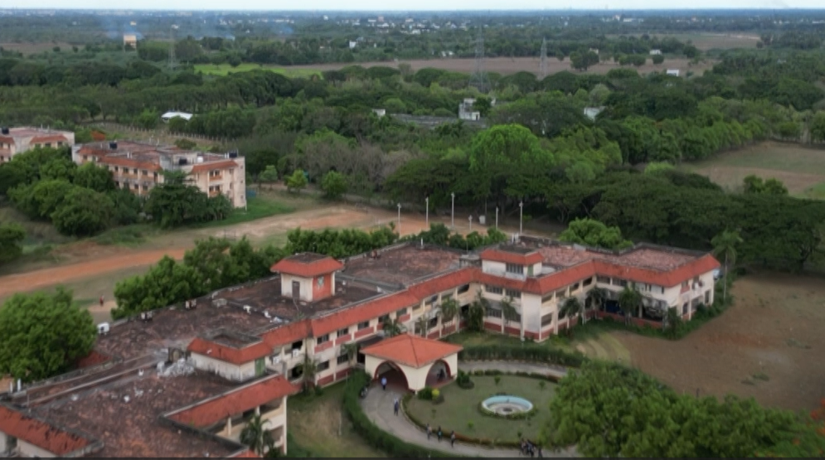
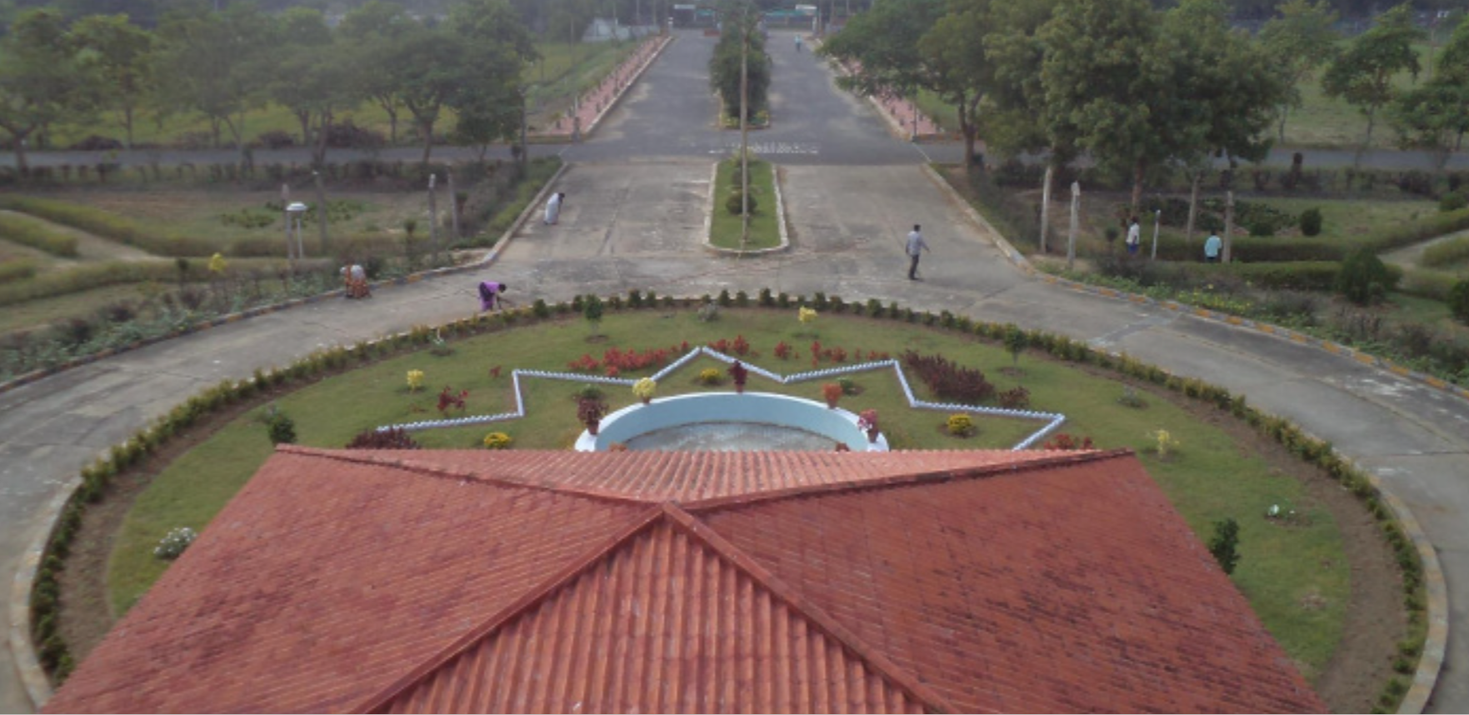
STAR COLLEGE SCHEME –
FUNDED BY DEPARTMENT OF BIO TECHNOLOGY (GOI)
SECOND ONLINE ADVISORY COMMITTEE MEETING – 18.08.2025 (MONDAY) – 3.00 to 5.00 pm
PANDIT JAWAHARLAL NEHRU COLLEGE OF AGRICULTURE AND RESEARCH INSTITUTE
(A Government of Puducherry Institution affiliated to Pondicherry University, Puducherry and accredited to ICAR, NAAC)
Serumavilangai, Nedungadu (PO),
KARAIKAL 609 603 - UT of Puducherry.

Slide 2


Welcome
Chairman’s address
Introduction and address by the DBT Representatives
Introduction and address by the External Experts
Briefing by the scheme coordinator
Presentation by the Department Coordinators
Video presentation
Interaction/remarks of the members
Conclusion
MEETING SCHEDULE

Slide 3
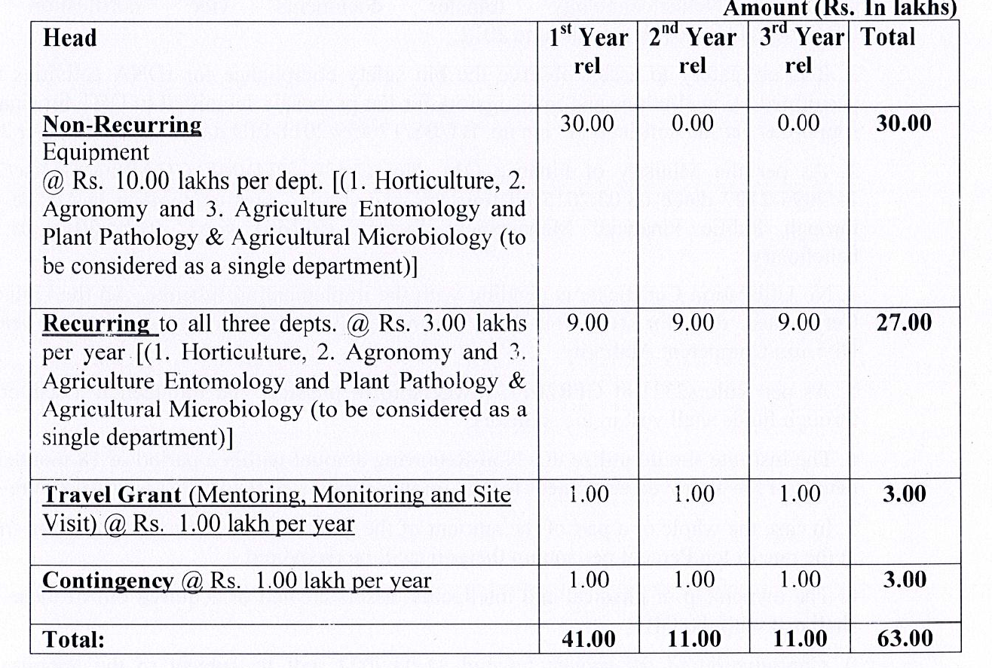
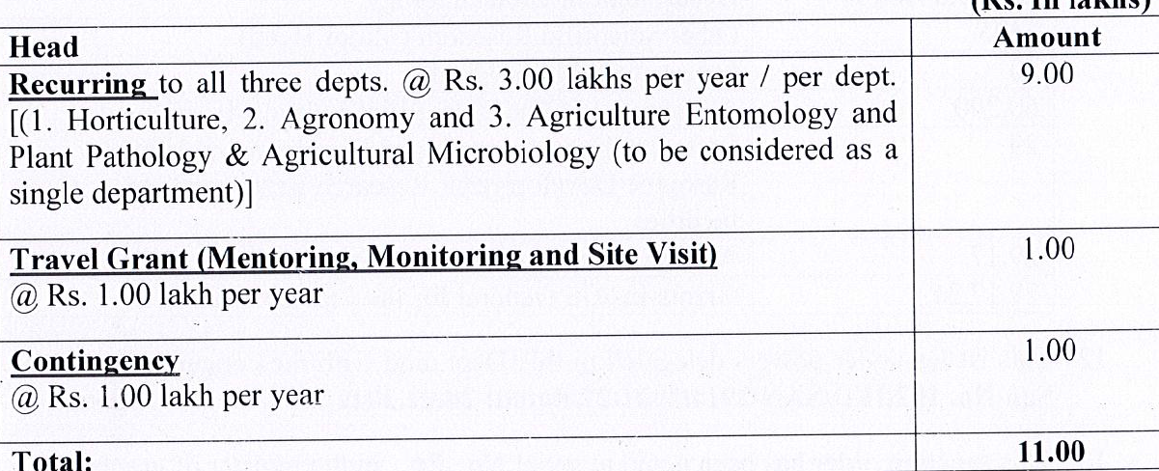
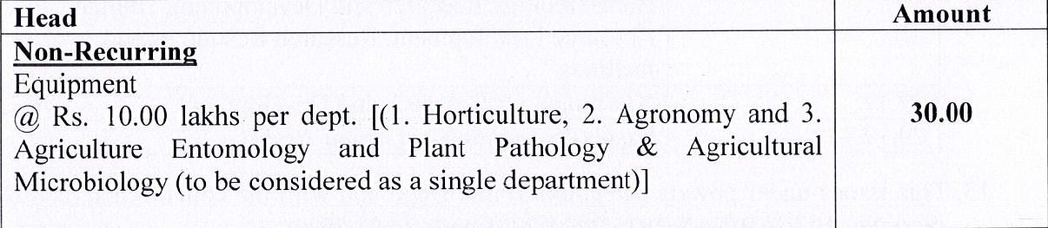







Slide 4
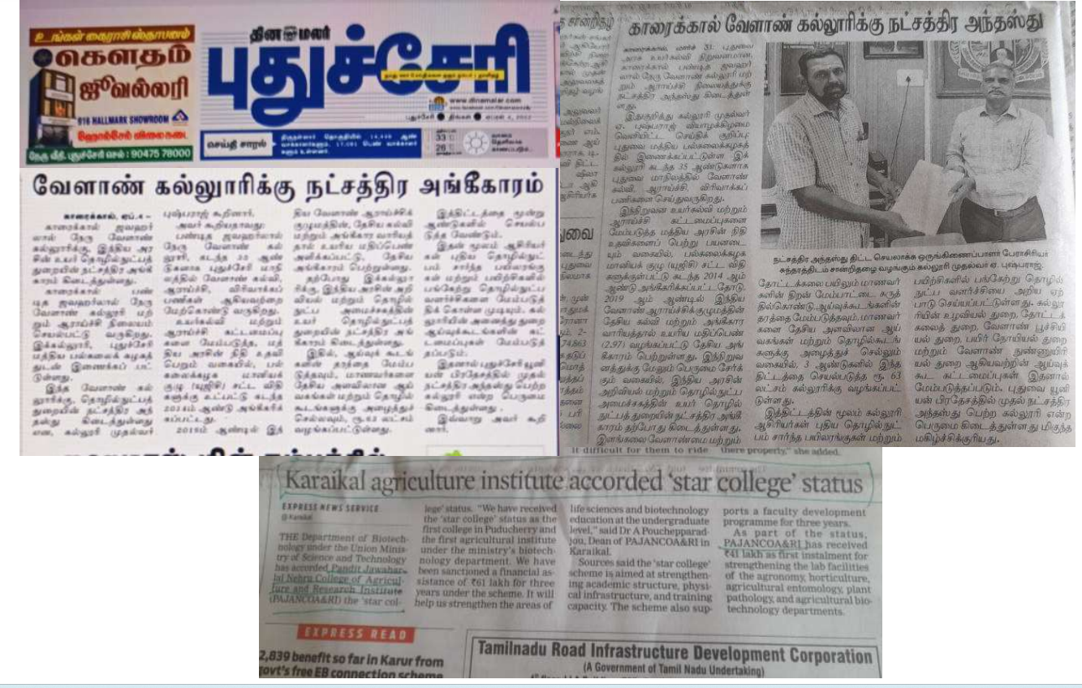

Slide 5
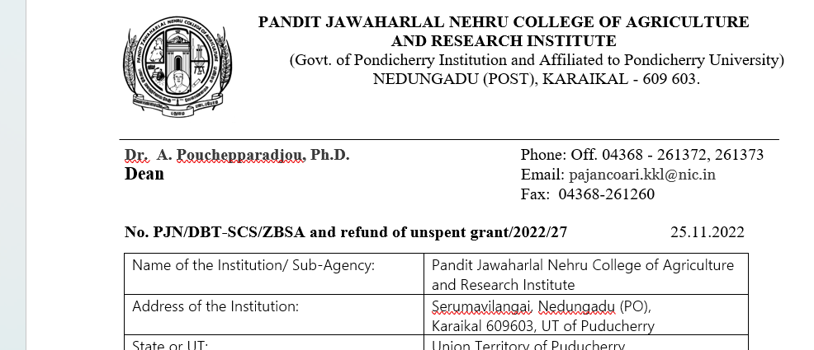
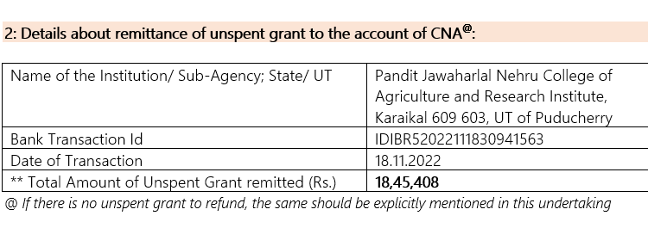

Slide 6
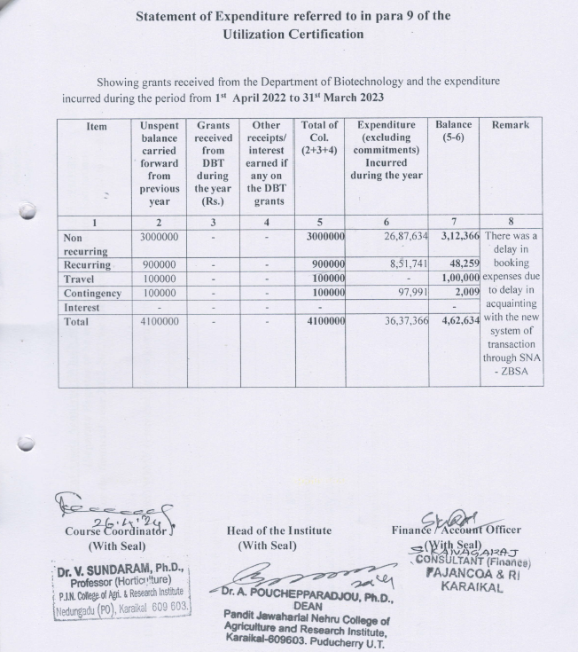
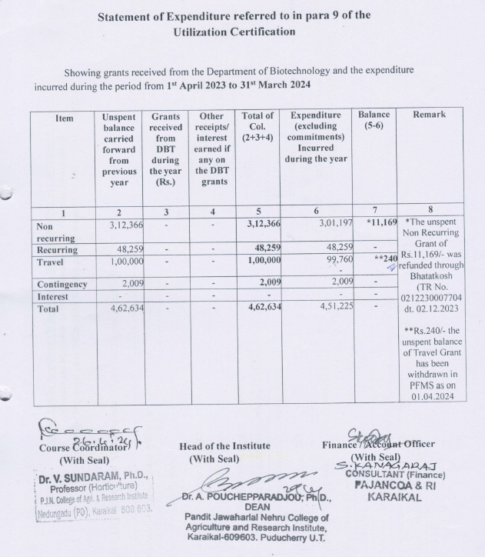

Slide 7
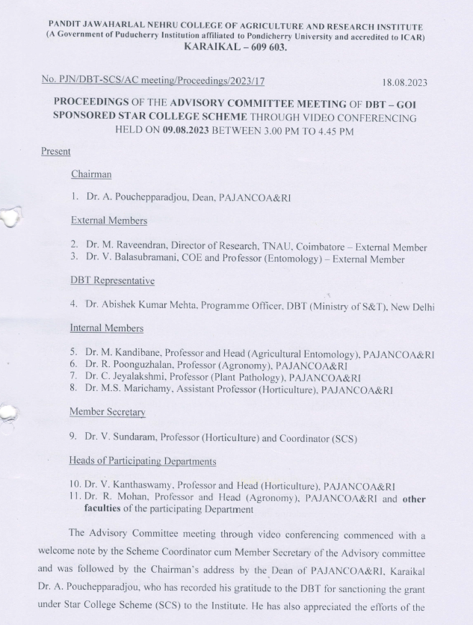
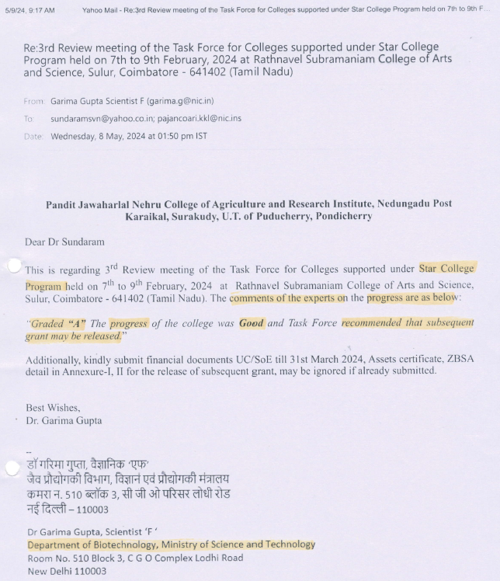




Slide 8
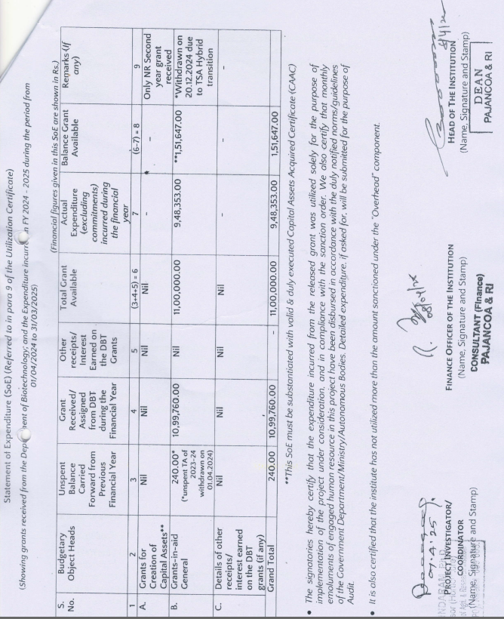
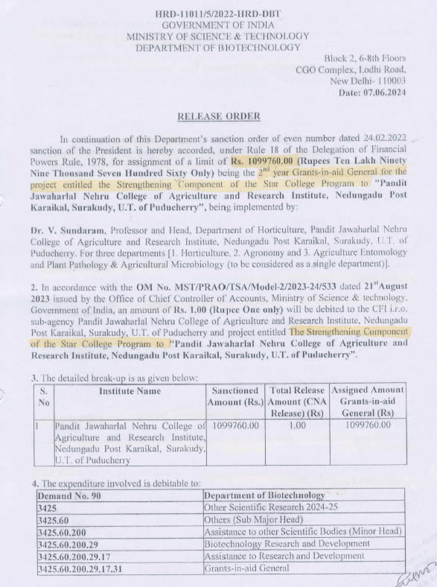

Slide 9
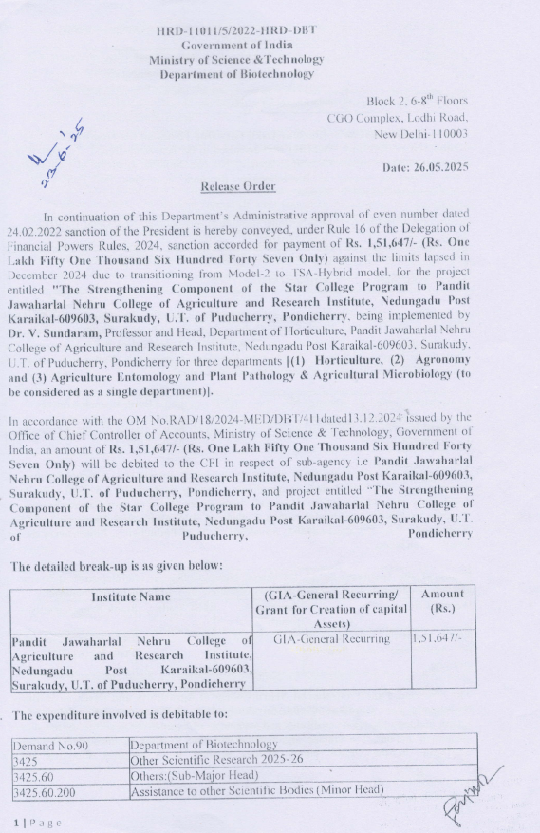
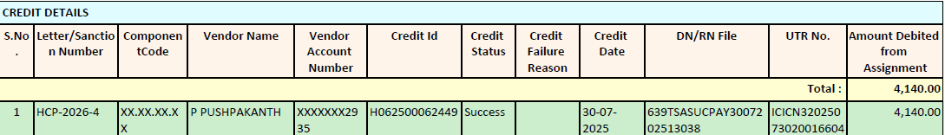
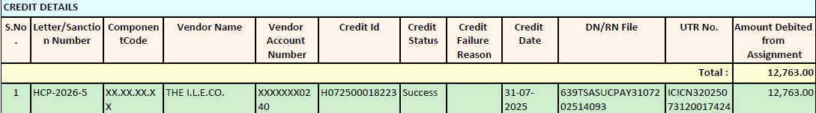
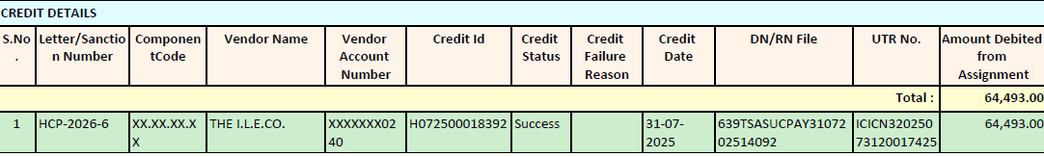
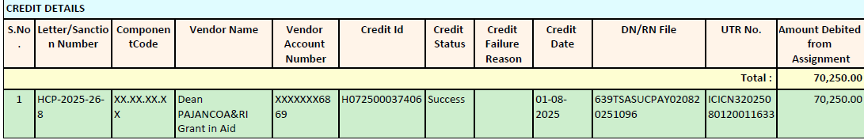

Amount released – Rs.1,51,647.00
Vendor Payment - Rs. 4140.00
- Rs. 12,763.00
- Rs. 64,493.00
- Rs. 70,250.00
__________
Total Expenditure - Rs. 1,51,646.00

Slide 10
FACULTHY STRENGTH OF SUPPORTING DEPARTMENTS
Sl. No. | Name of Department | Courses (B.Sc./M.Sc./PG Diploma, certificate etc.) offered | Regular Faculty members Total = 21
 |  |  | With Ph.D. | Without Ph.D.
01 | Agronomy | B.Sc. (Hons.) Agriculture B.Sc. (Hons.) Horticulture M.Sc. (Agri.) Agronomy | 08 | -
02 | Horticulture | B.Sc. (Hons.) Agriculture B.Sc. (Hons.) Horticulture M.Sc. (Hort.) Vegetable Science | 05 | -
03 | Agricultural Entomology | B.Sc. (Hons.) Agriculture B.Sc. (Hons.) Horticulture M.Sc. (Agri.) Entomology | 05 | -
04 | Agricultural Microbiology | B.Sc. (Hons.) Agriculture B.Sc. (Hons.) Horticulture | 01 | -
05 | Plant Pathology | B.Sc. (Hons.) Agriculture B.Sc. (Hons.) Horticulture | 03 | -

Slide 11
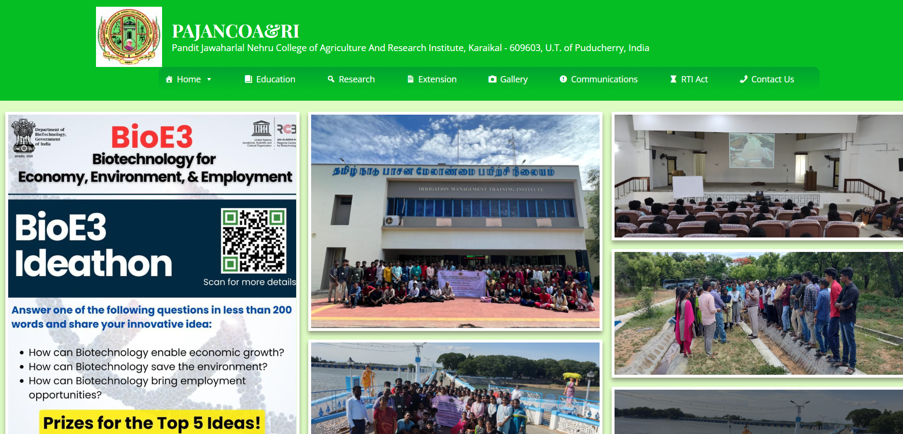
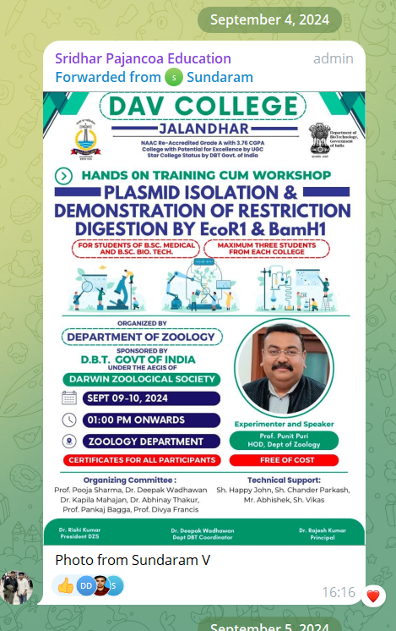
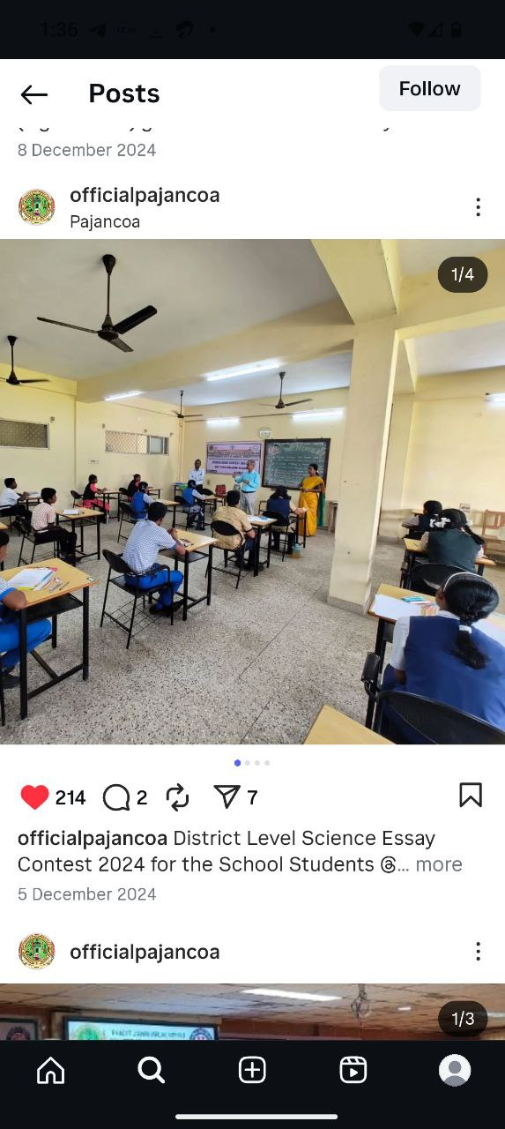
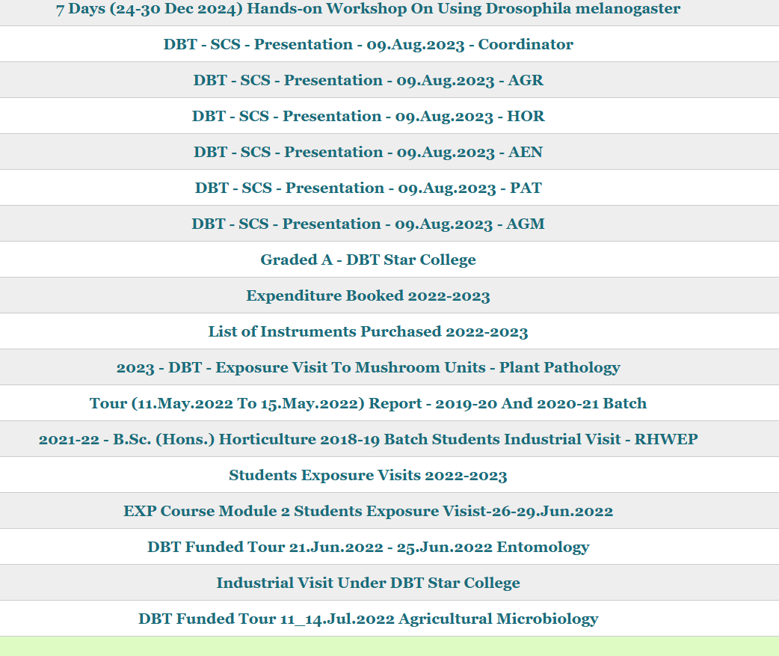
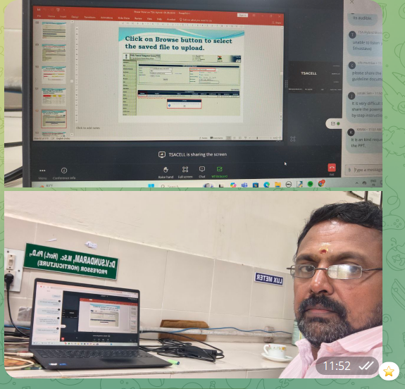
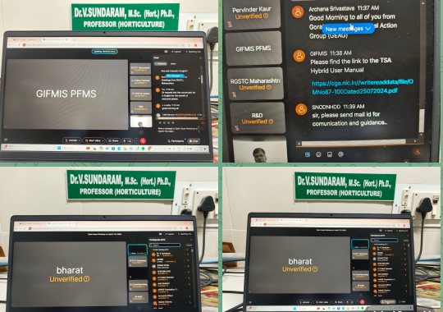
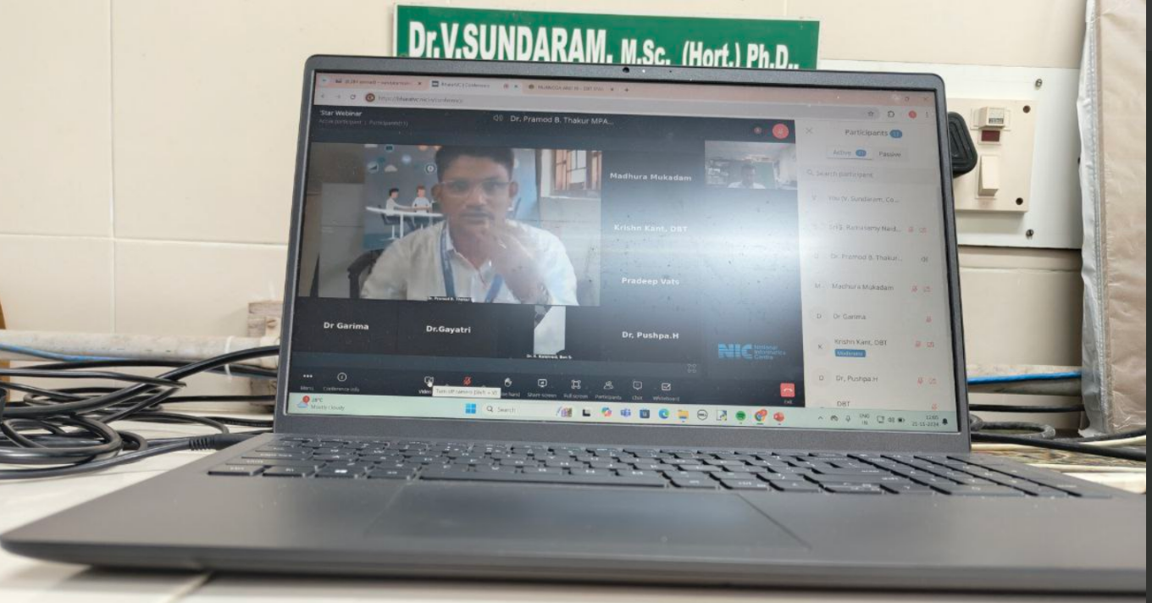
Use of social media and website

Slide 12
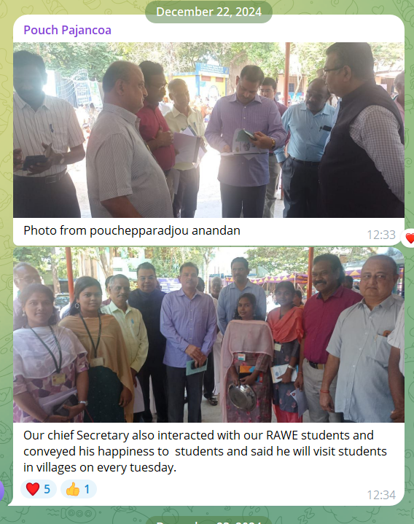
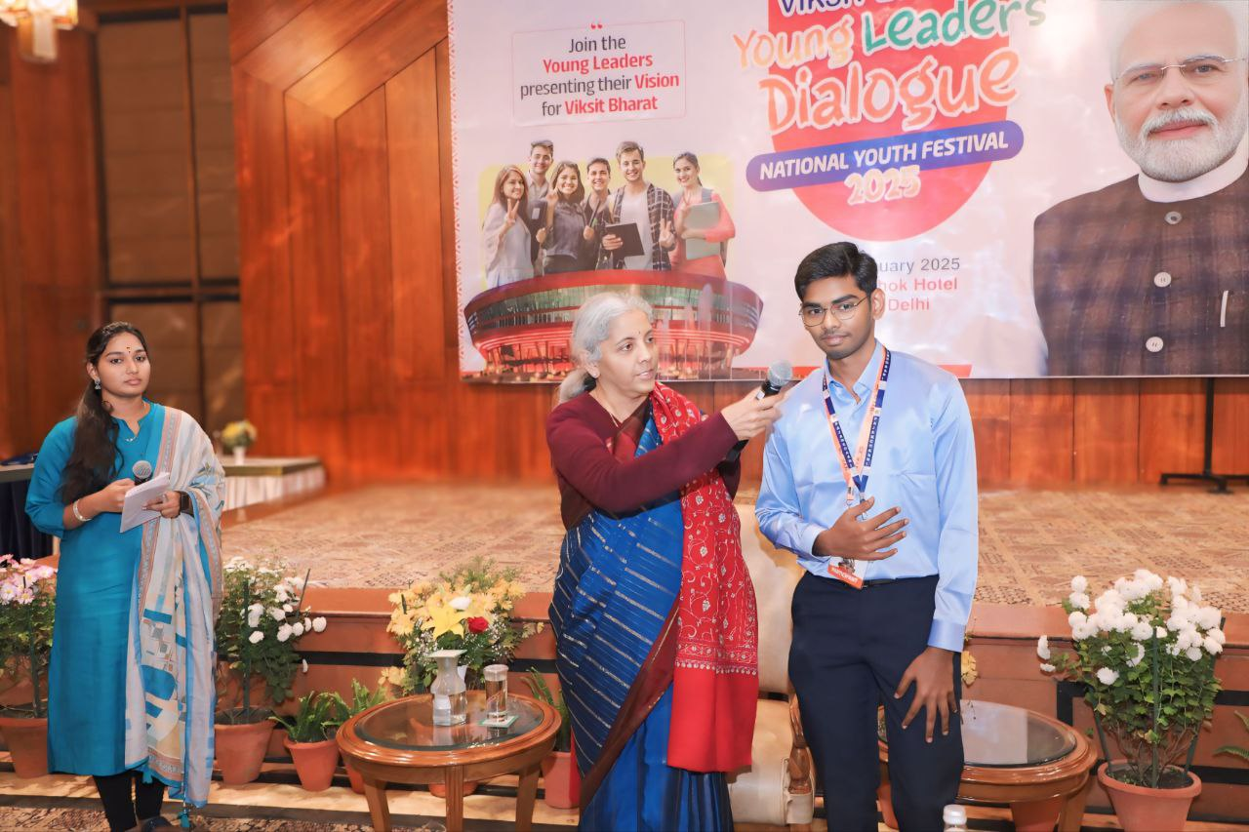
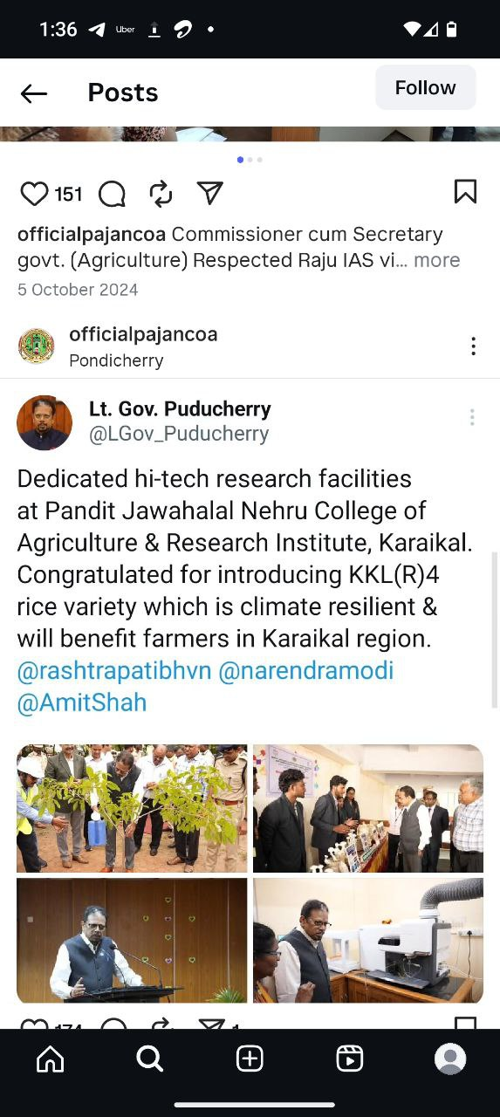
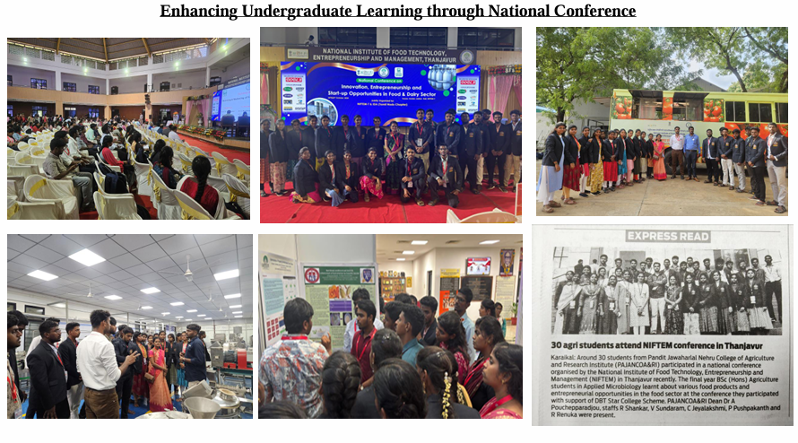
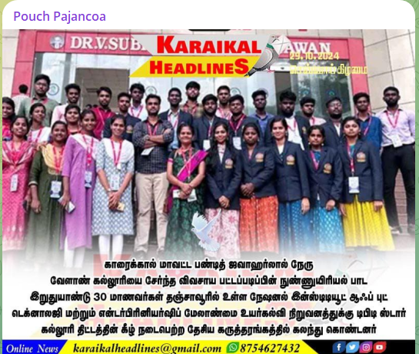
STUDENT’S EXCELLENCE AND APPRECIATION

Slide 13
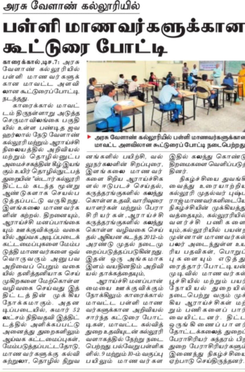
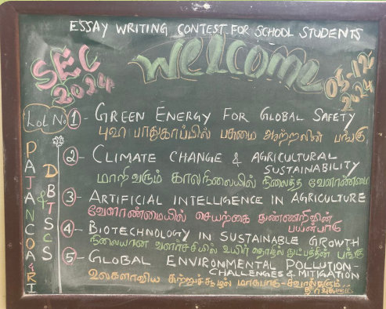
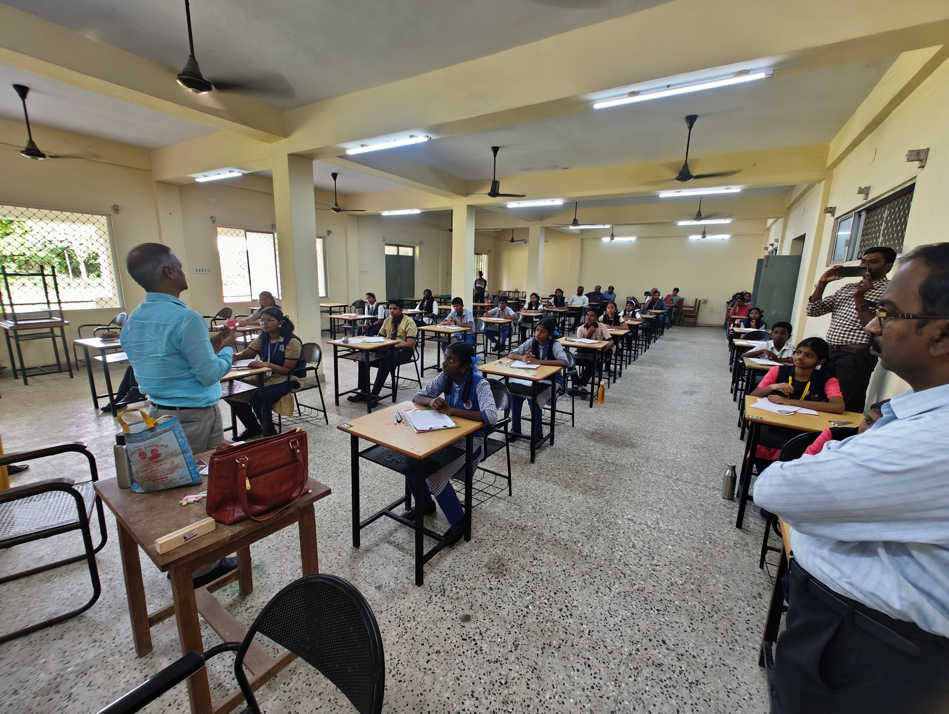
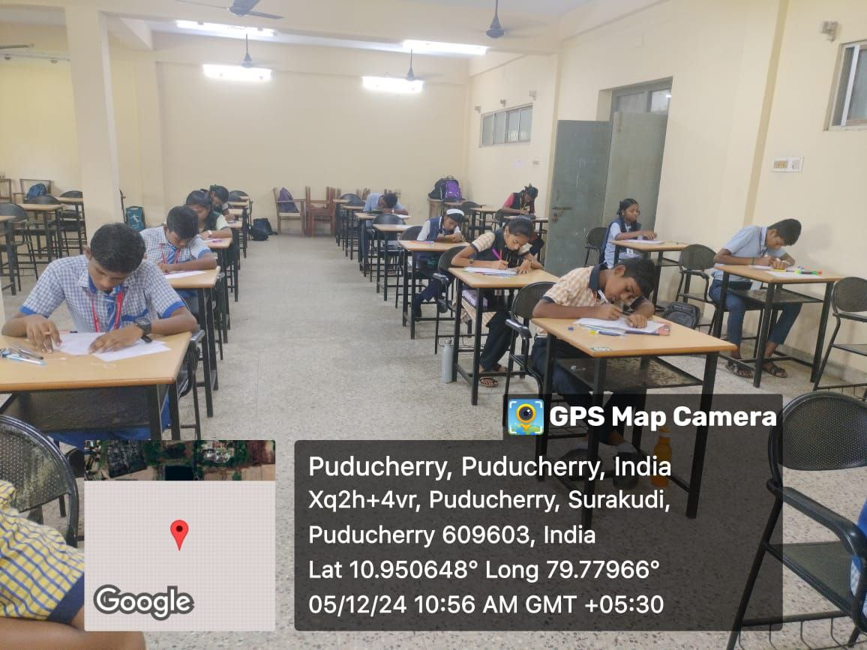
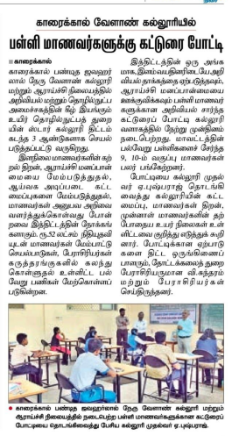
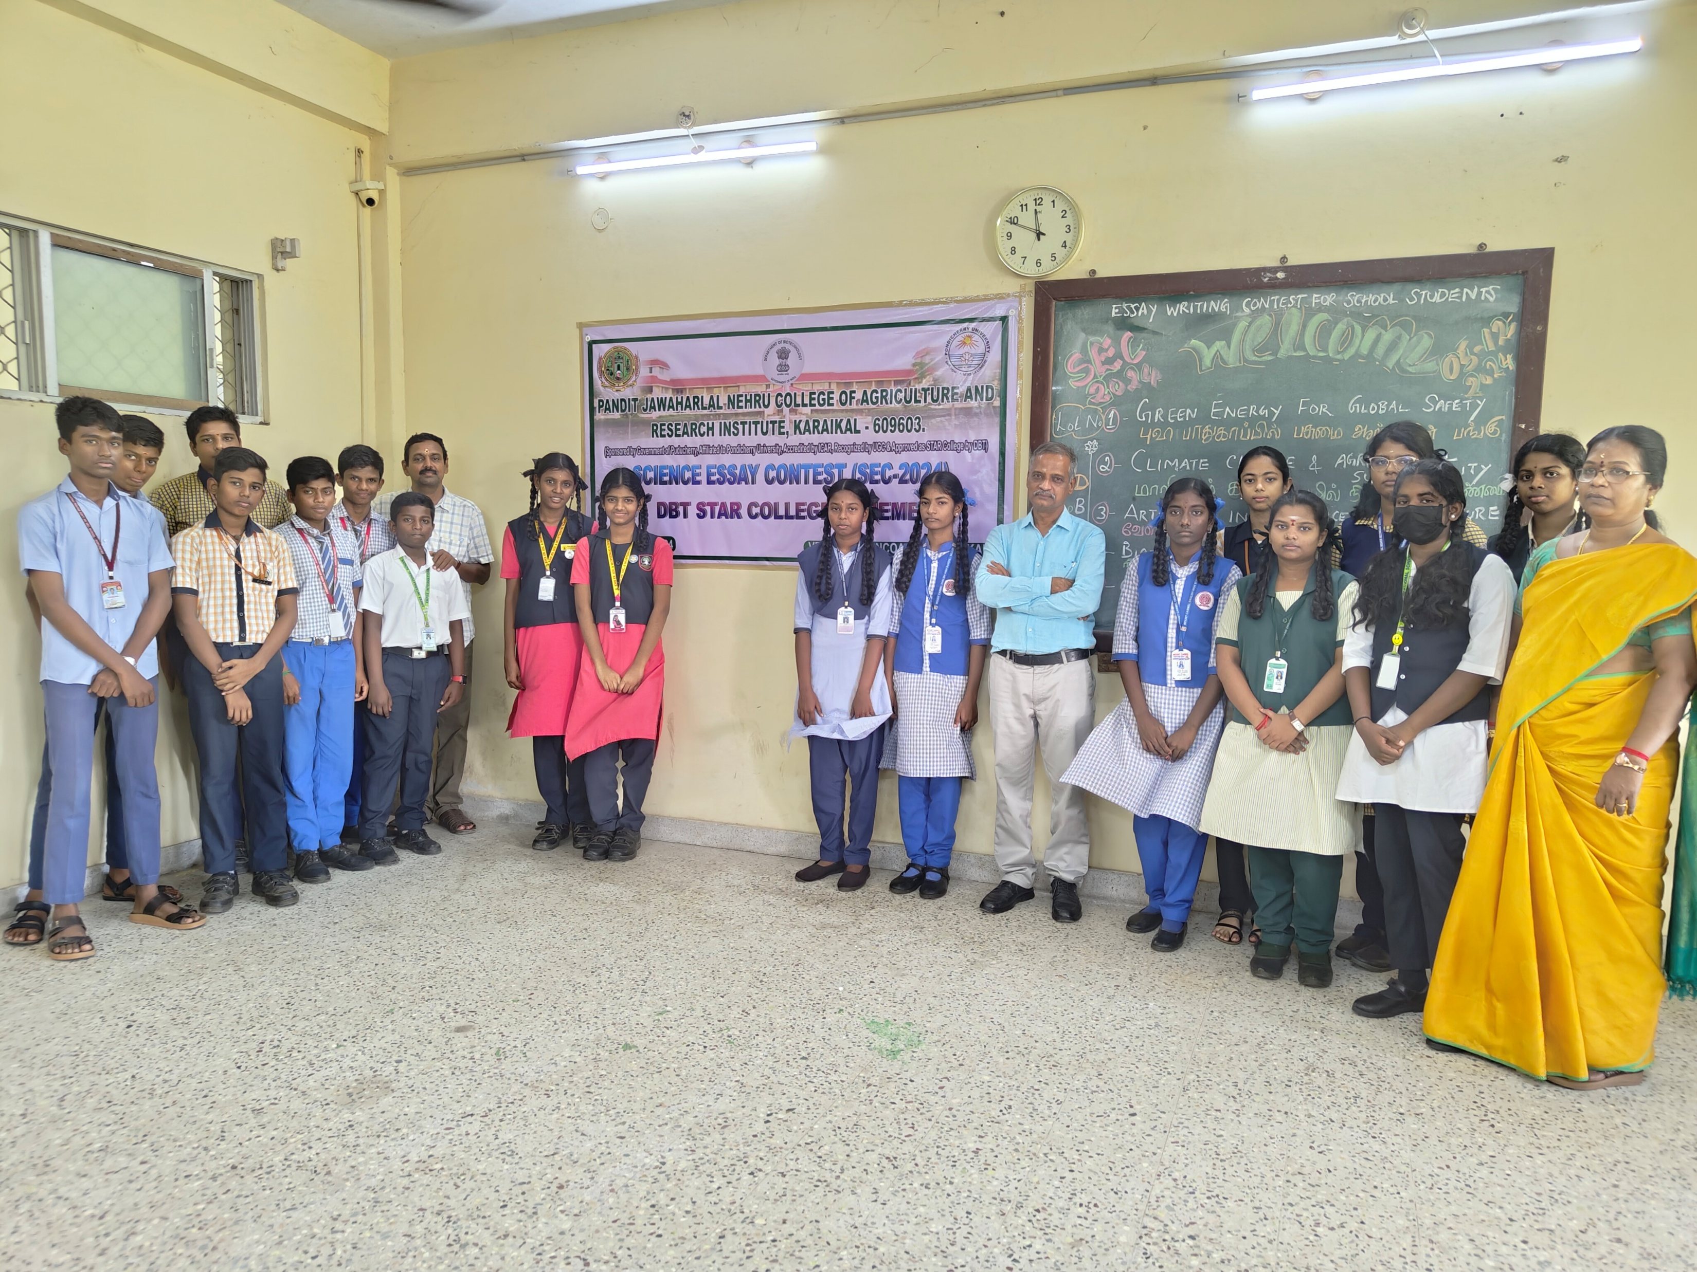
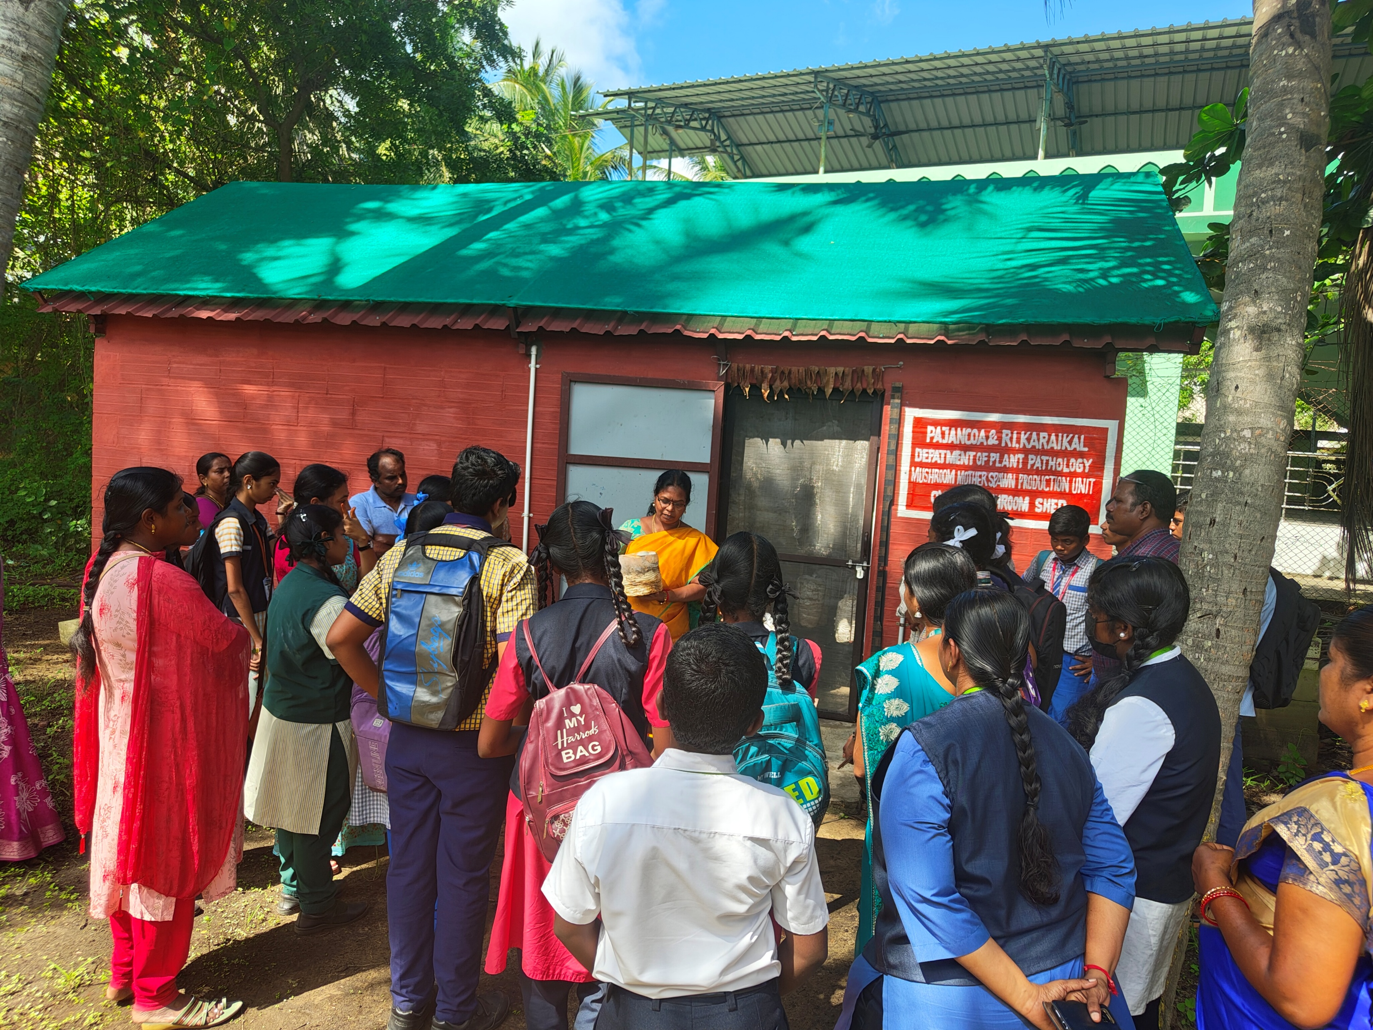
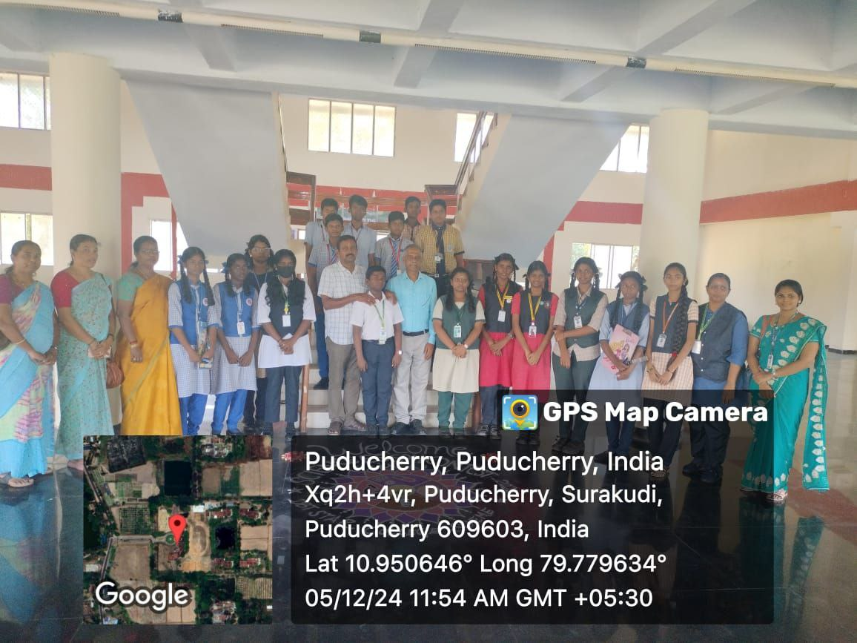

DISTRICT LEVEL ESSAY COMPETITION FOR HIGH SCHOOL STUDENTS – 05.12.2024

Slide 14
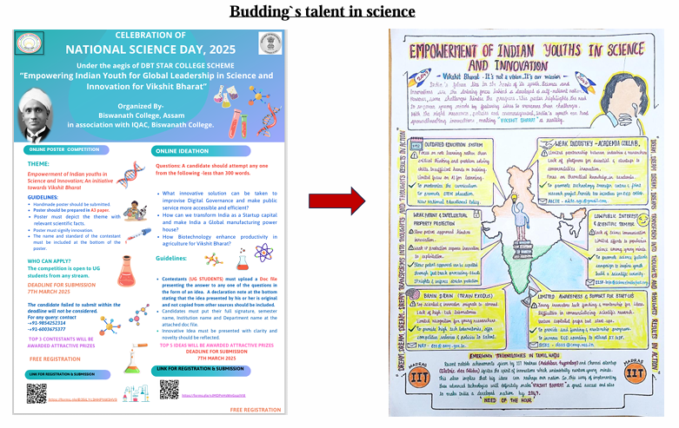
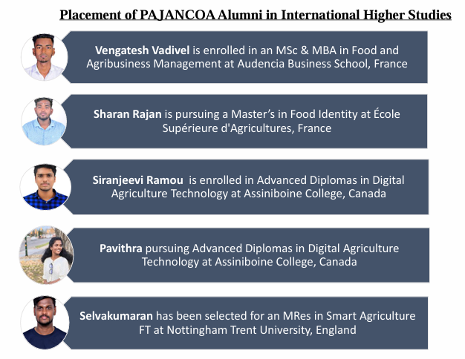
Mentored by
Dr. Pushpakanth
AP (Agricultural Microbiology)

Slide 15
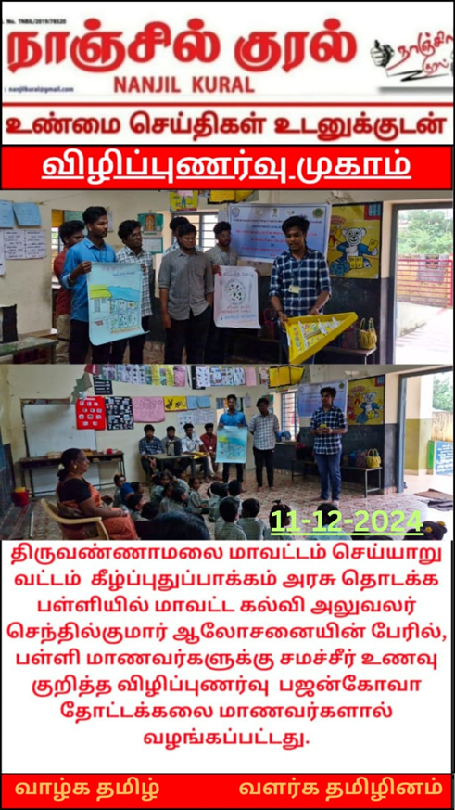
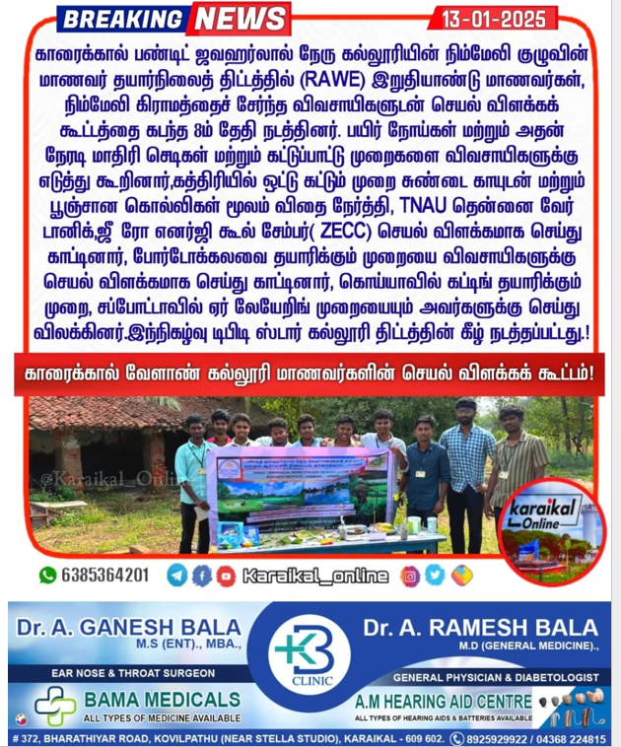
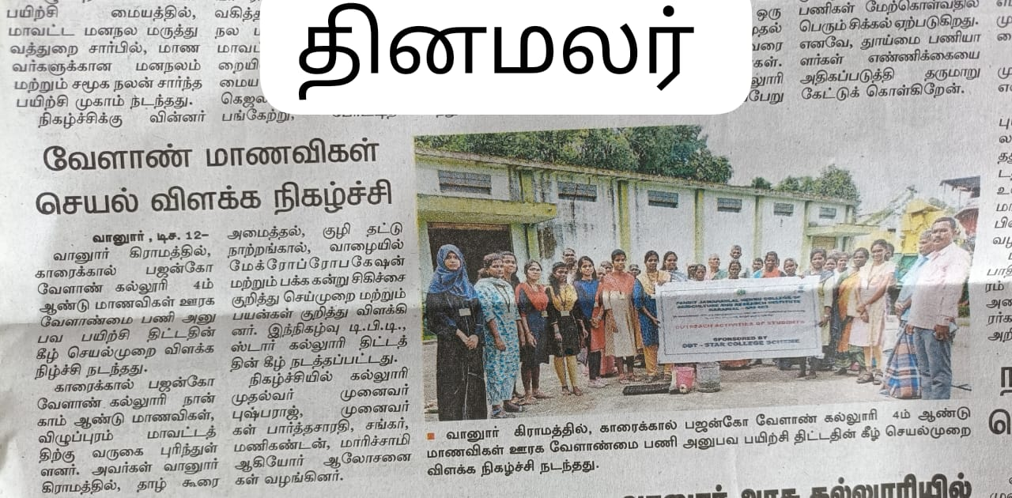
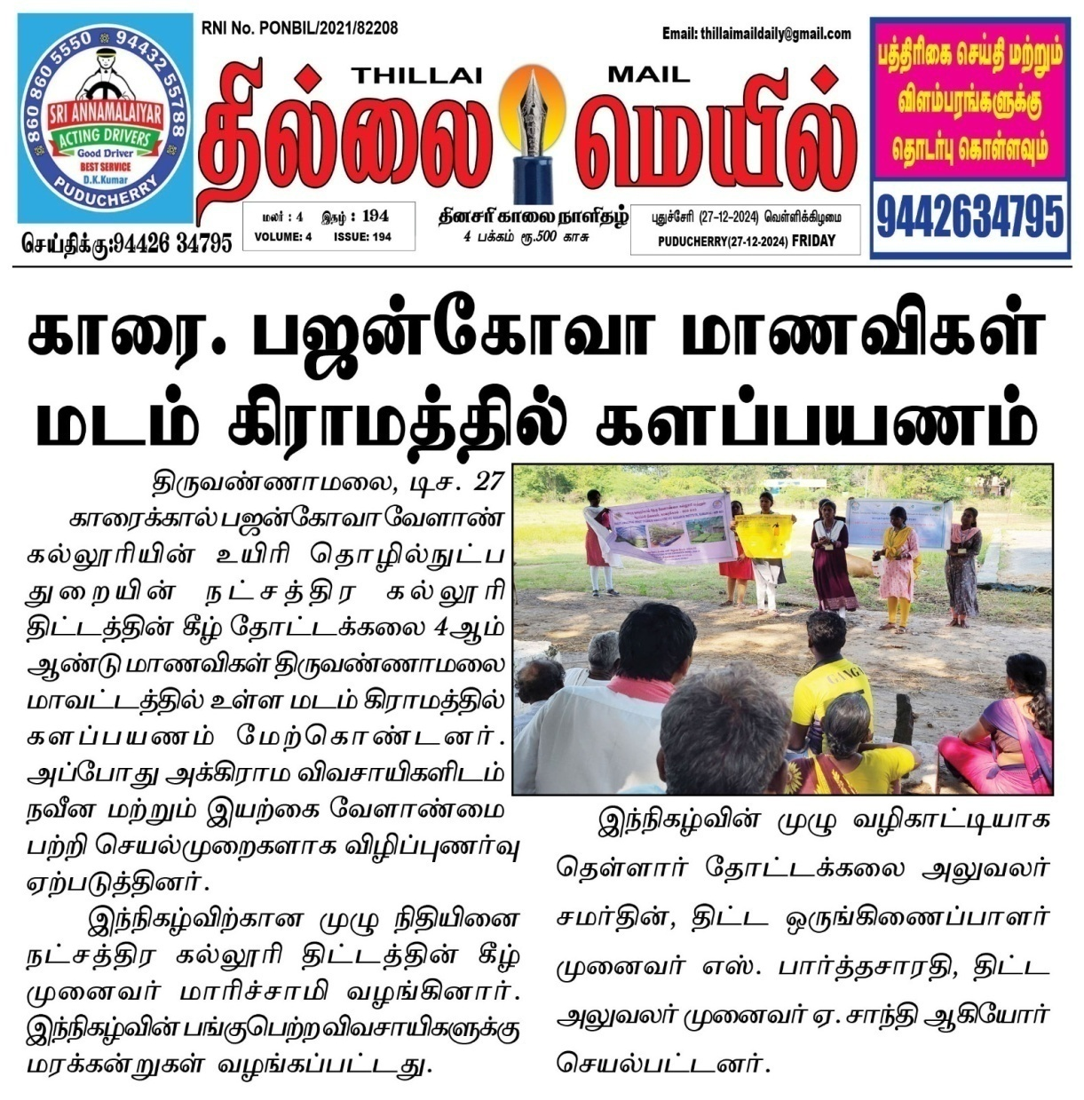
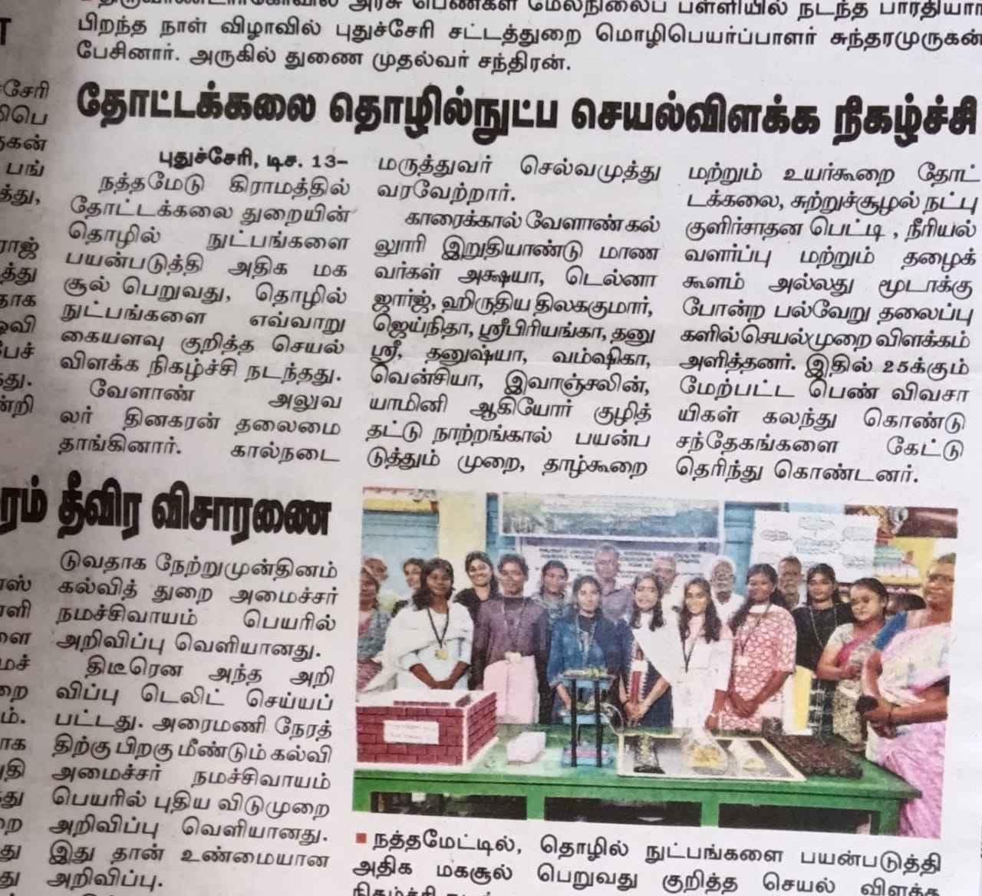
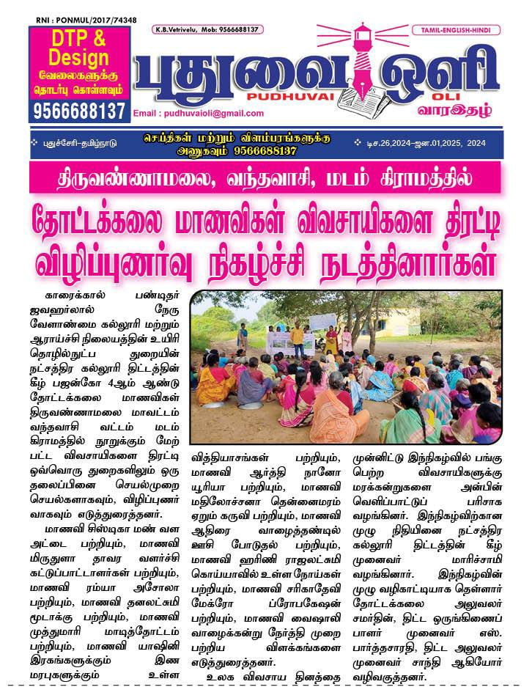
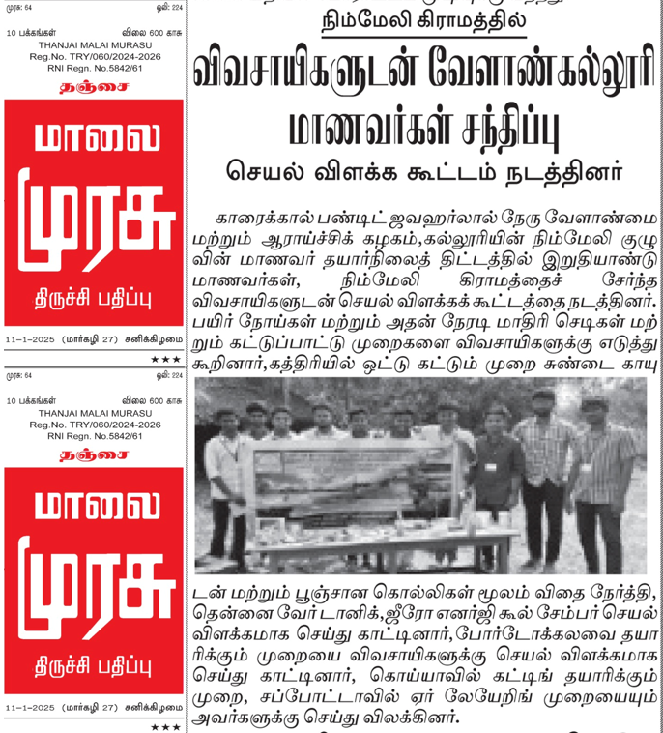
IN THE NEWS - PAJANCOA&RI SCS ACTIVITIES
RURAL WORK EXPERIENCE OF FINAL YEAR STUDENTS CAPTURED
TRAININGS / DEMONSTRATIONS ON TECHNOLOGY TRANSFER

Slide 16


