Slide 1
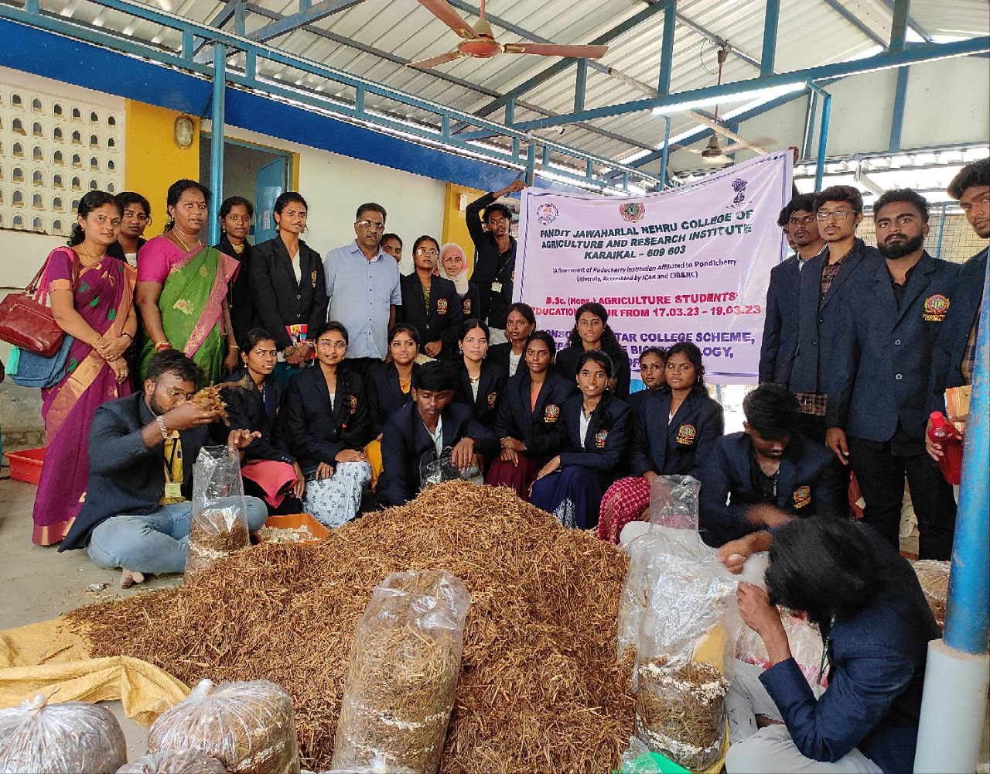
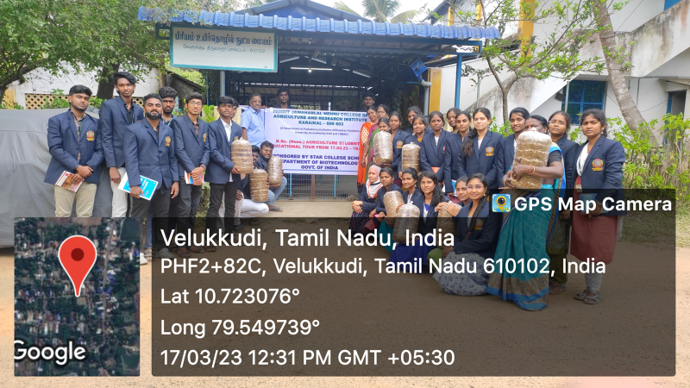
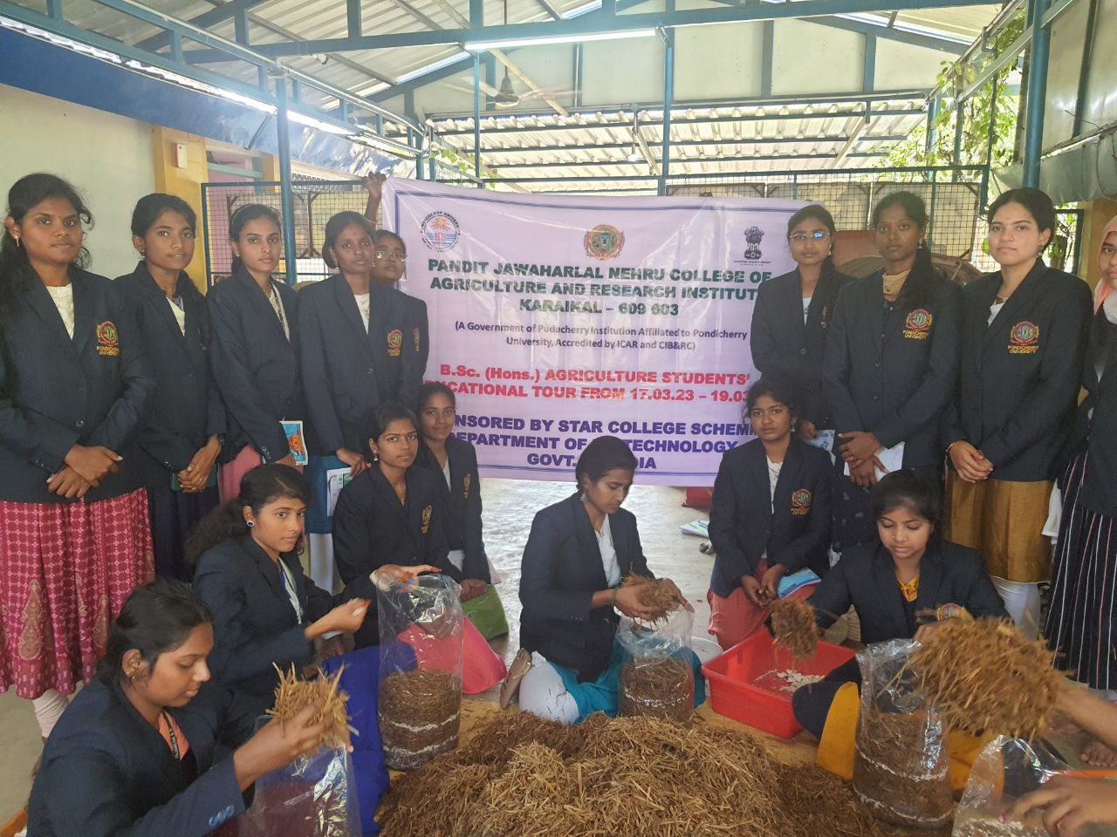
Hands on training on Oyster Mushroom Cultivation to ELP 413 Students at M/S Piriyum Biotech Centre, Velukudi, Thiruvarur under DBT- STAR COLLEGE SCHEME

Slide 2
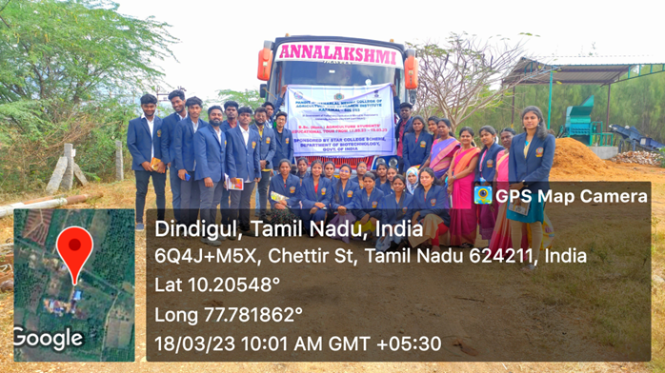
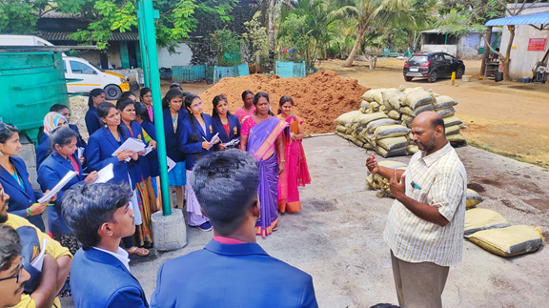
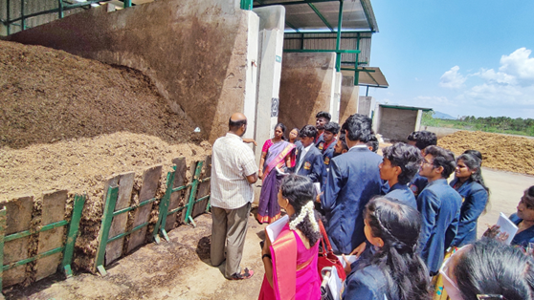
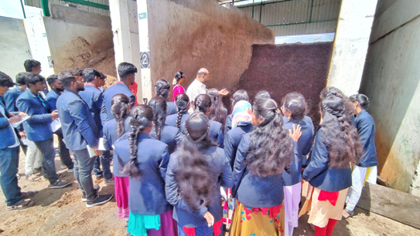
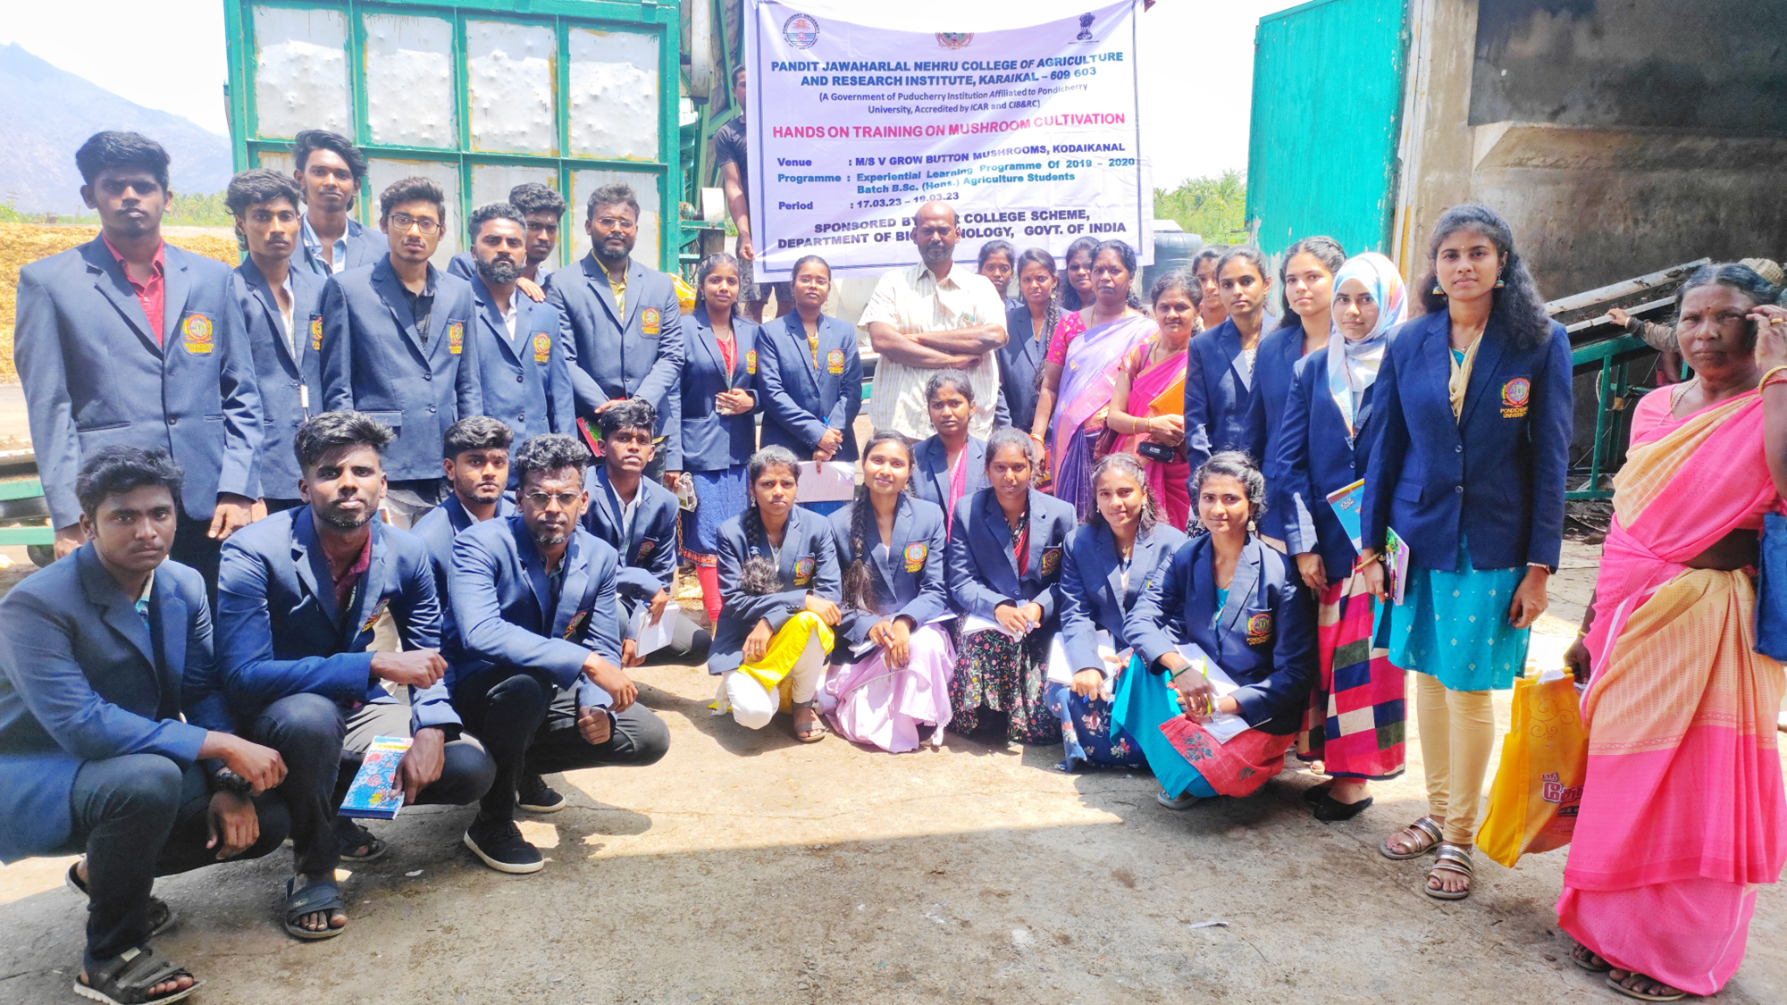
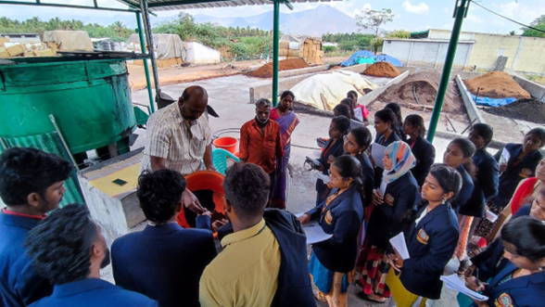
ELP 413 Students Visit to Compost Preparation Yard of M/S V Grow Button Mushroom at Pattiveeranpatti, Dindigul under DBT- STAR COLLEGE SCHEME

Slide 3
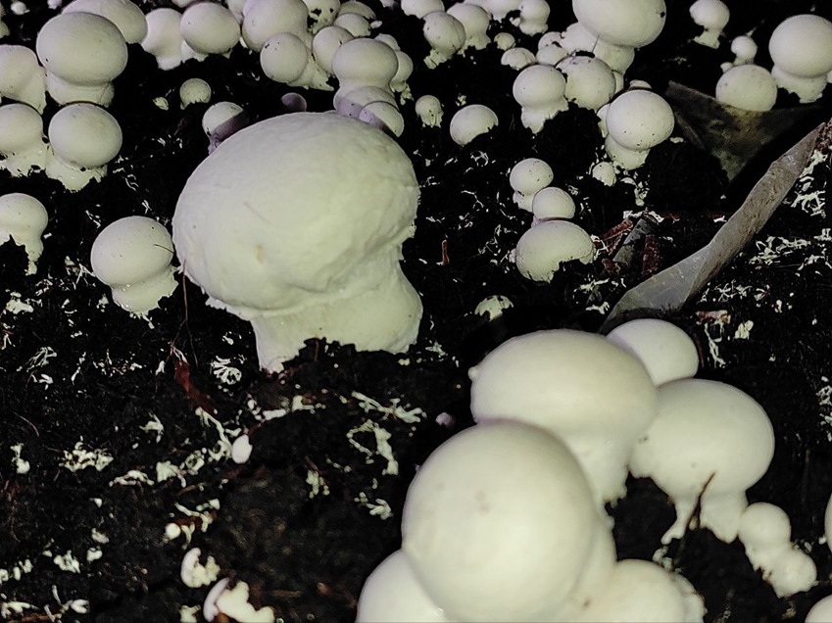
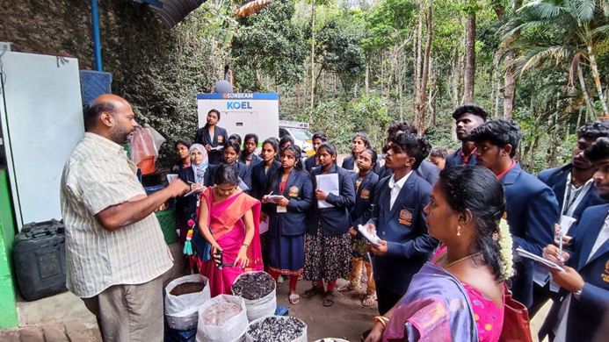
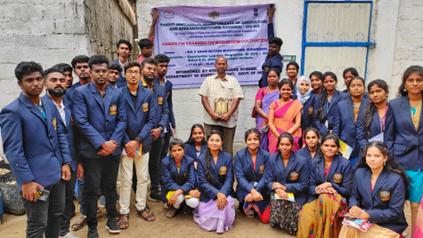
ELP 413 Students Visit to M/S V Grow Button Mushroom at Thandikudi, Kodaikanal under DBT- STAR COLLEGE SCHEME

